Slide 1


Instructor Resources
Chapter 3 Figures
Cover photo: BeautyStock – stock.adobe.com.

Slide 2
Chapter 3
Turbine Engine
and Propeller Systems

Slide 3
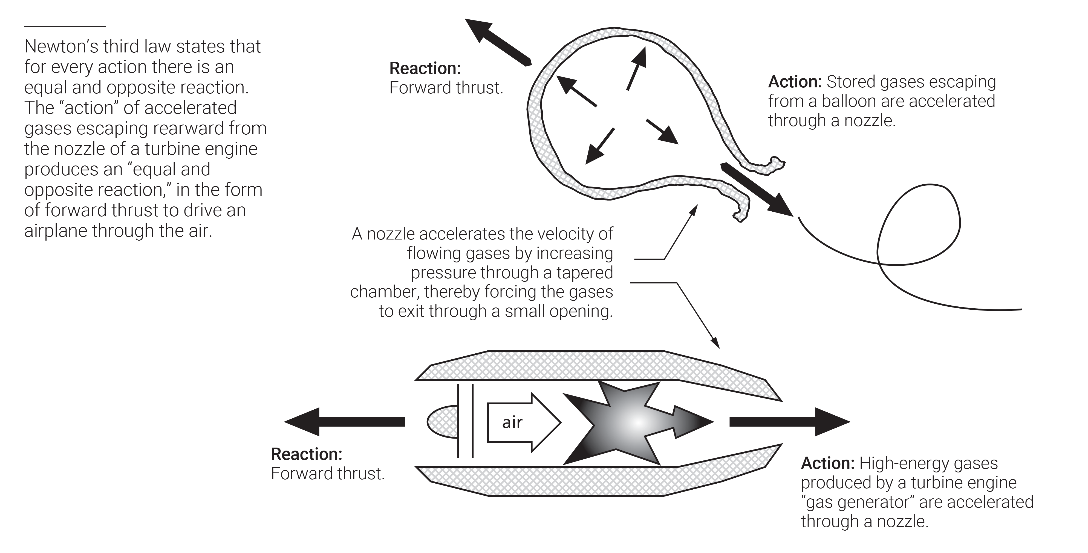
FIGURE 3.1
Reaction engines: a balloon and a gas turbine engine.

Slide 4
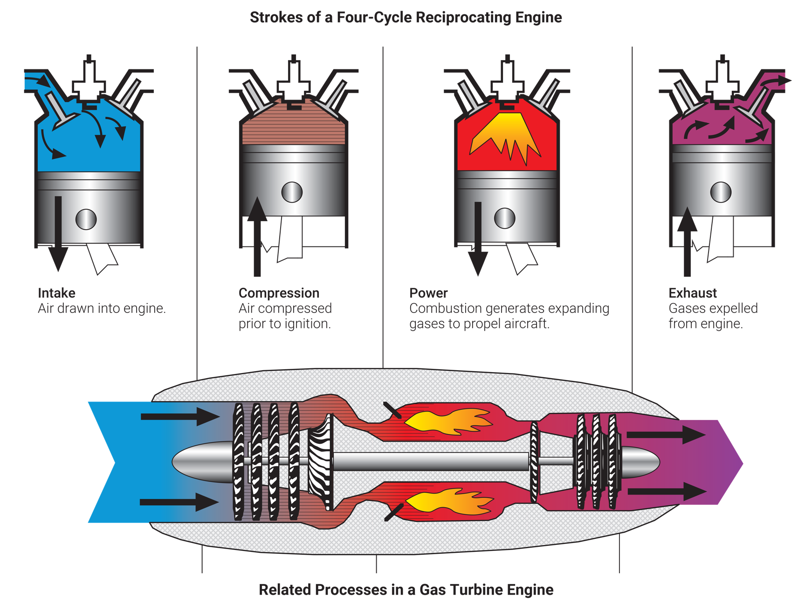
FIGURE 3.2
Power strokes in reciprocating engines and associated processes in turbine engines.

Slide 5
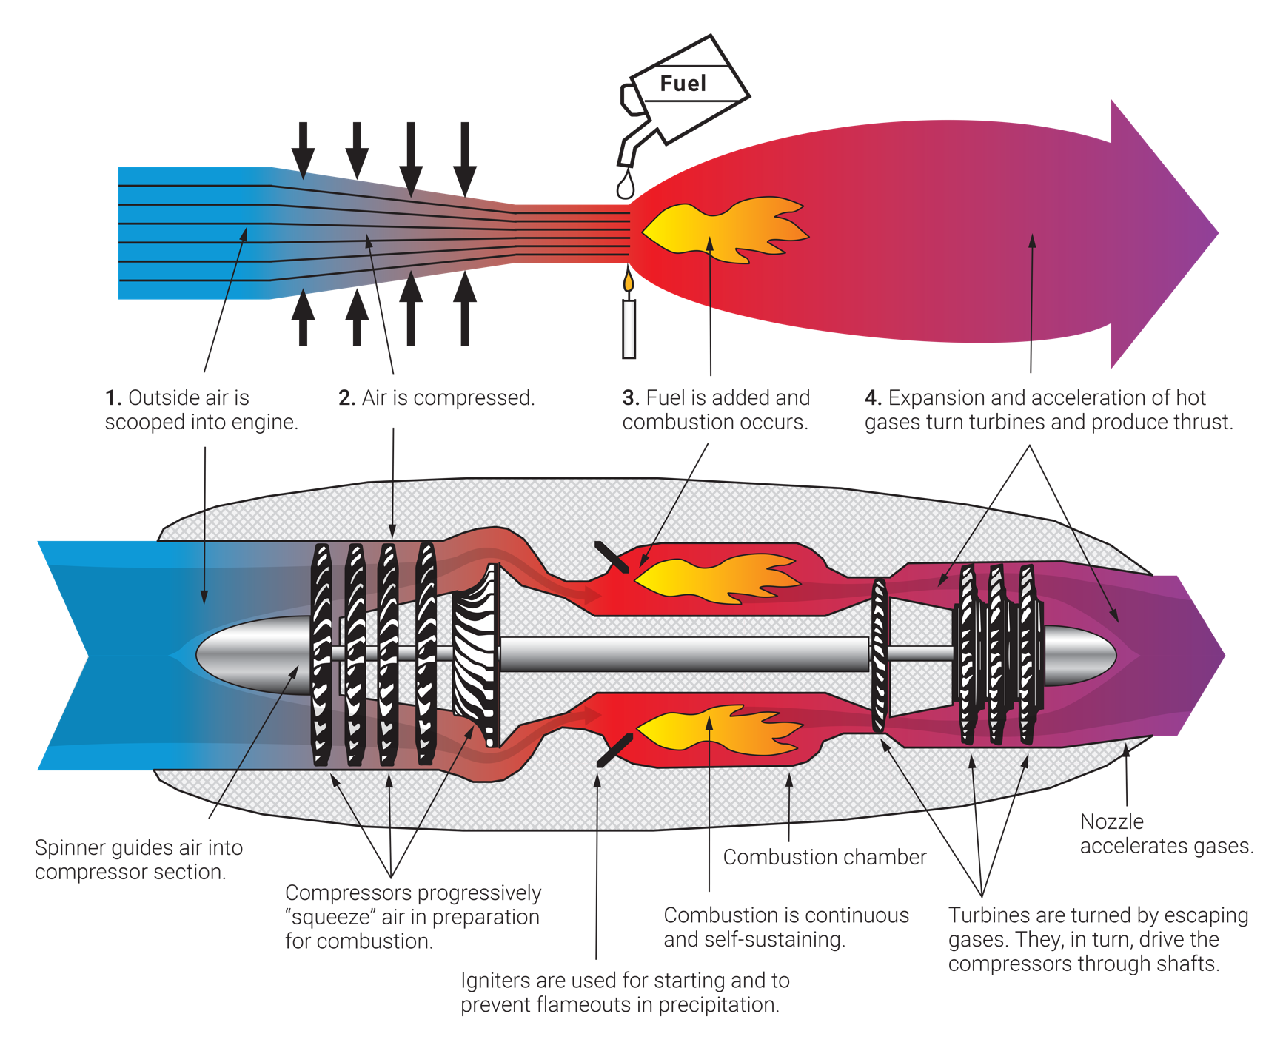
FIGURE 3.3
How a gas turbine engine works.

Slide 6
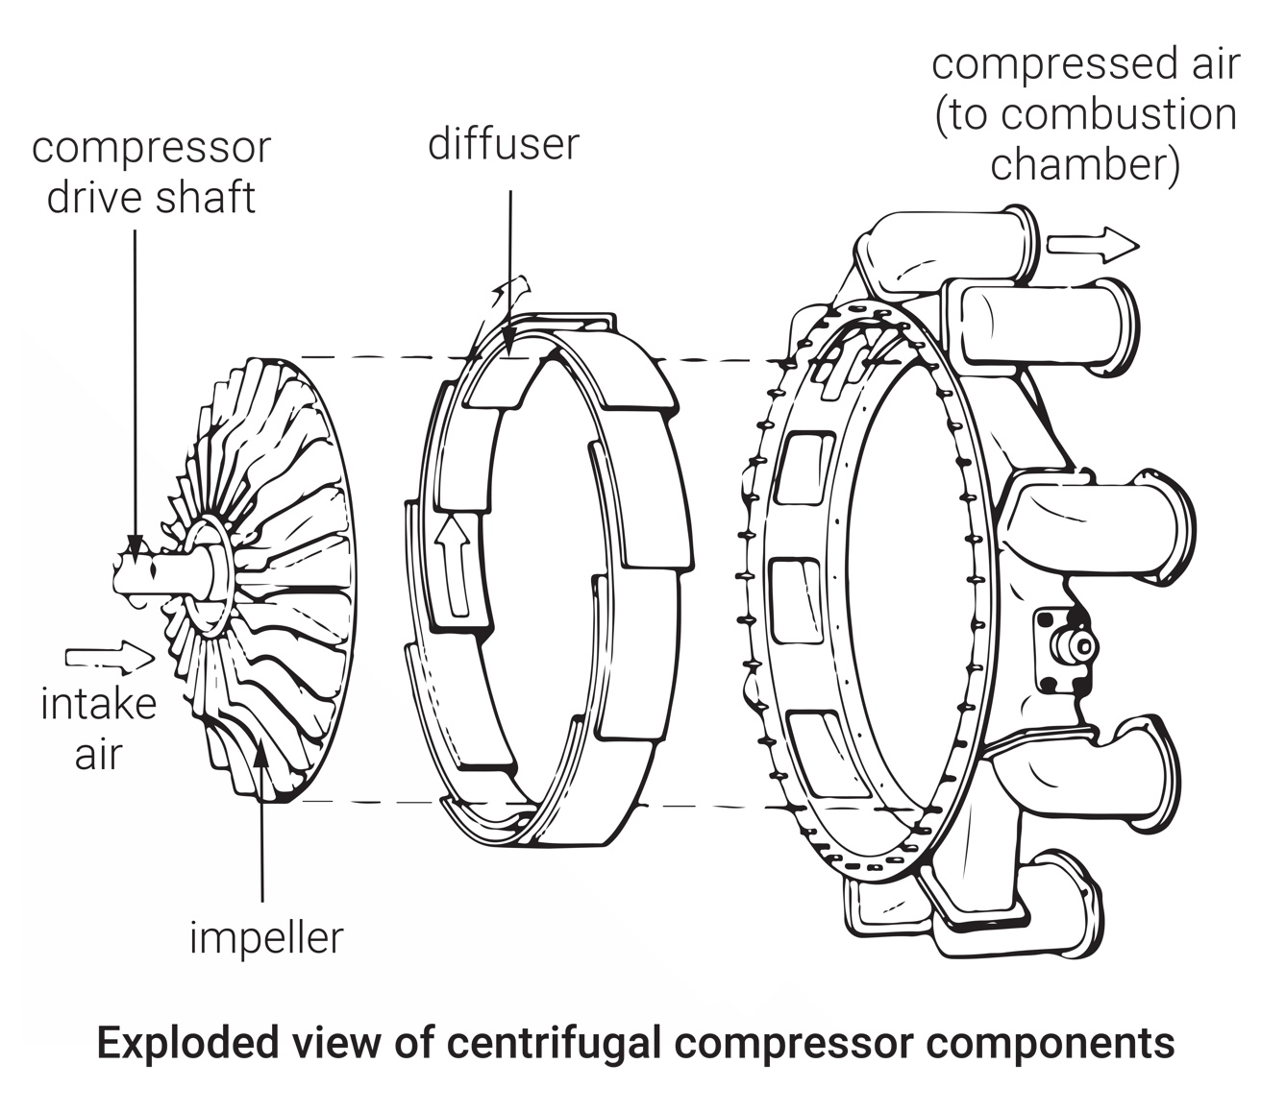
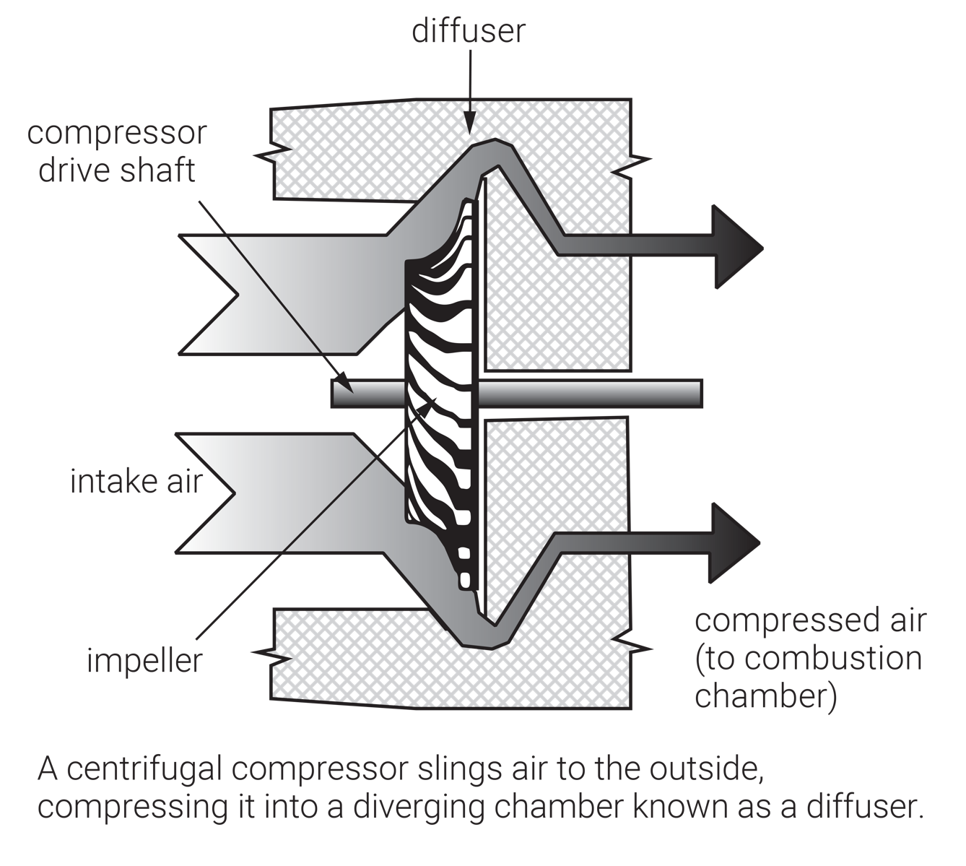
FIGURE 3.4
Centrifugal-flow compressor.
Exploded view courtesy of United Technologies Pratt & Whitney.

Slide 7
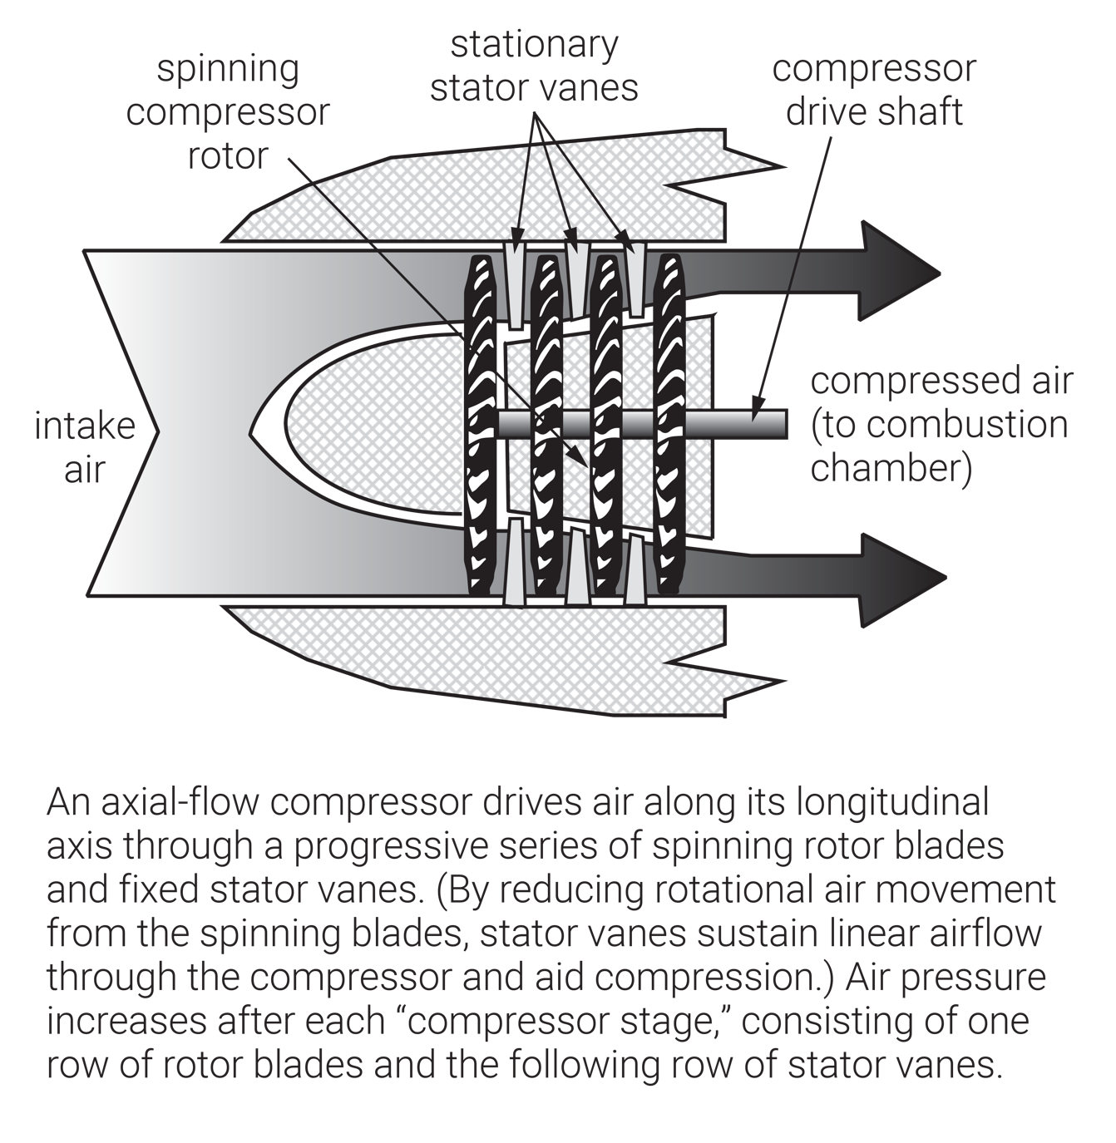
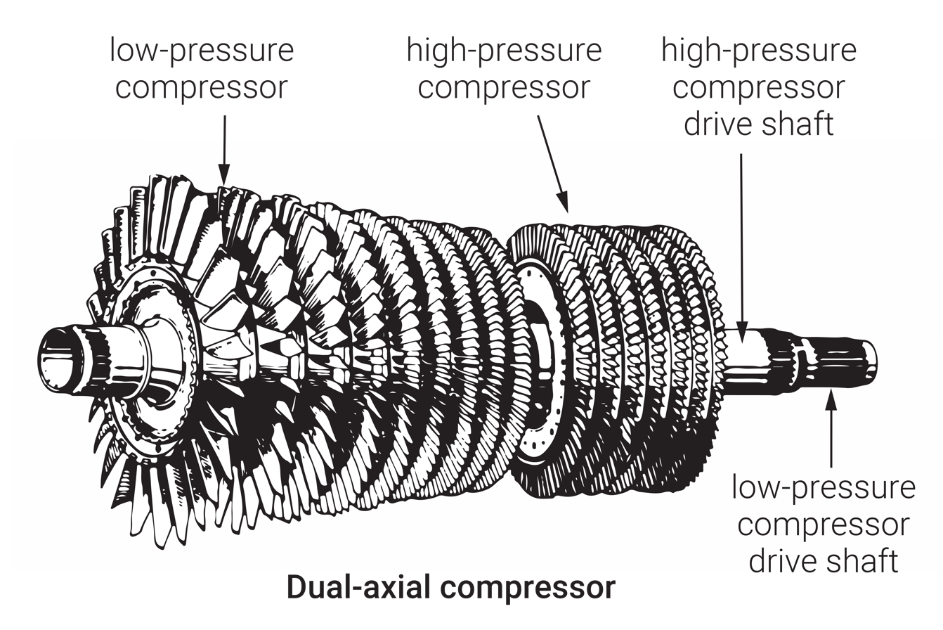
FIGURE 3.5
Axial-flow compressor.
Dual-axial compressor courtesy of United Technologies Pratt & Whitney.

Slide 8
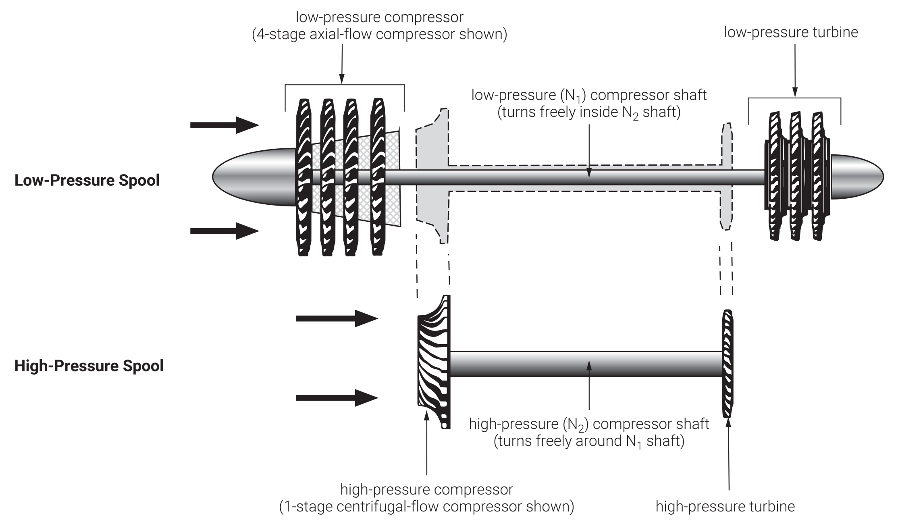
FIGURE 3.6
High- and low-pressure assemblies of a two-spool turbine engine.

Slide 9
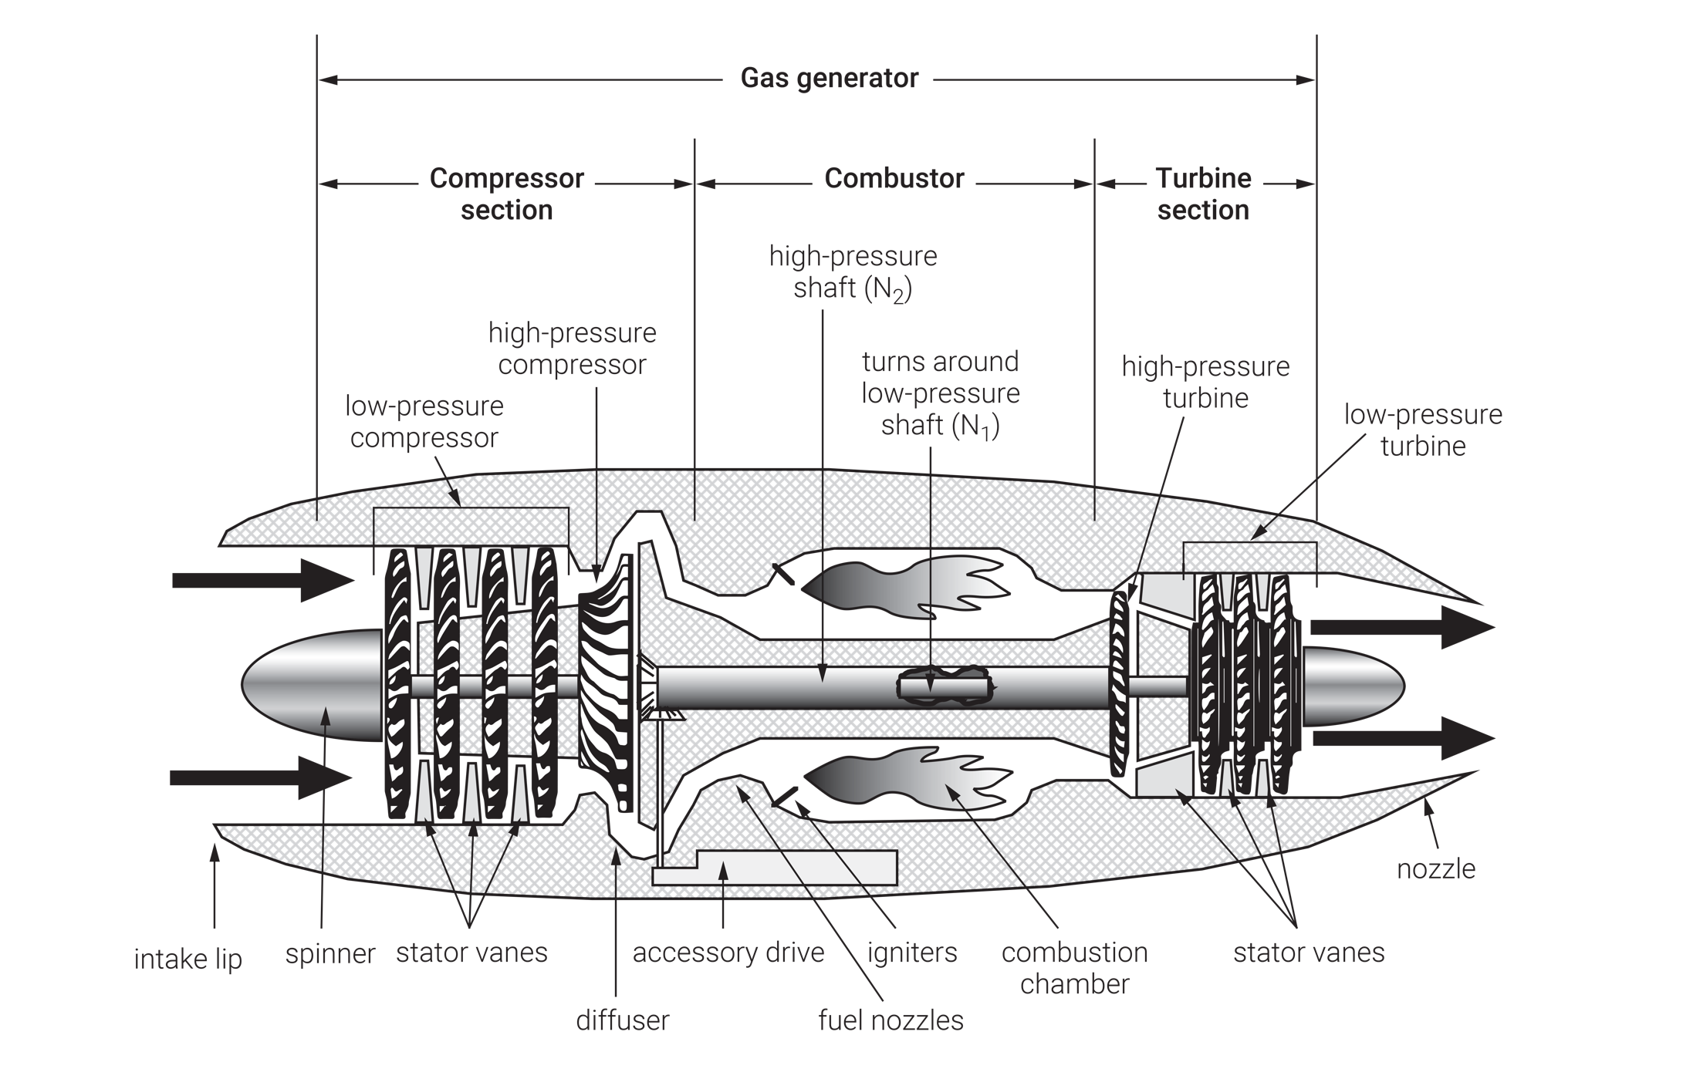
FIGURE 3.7
Basic components of a two-spool core turbine engine.

Slide 10
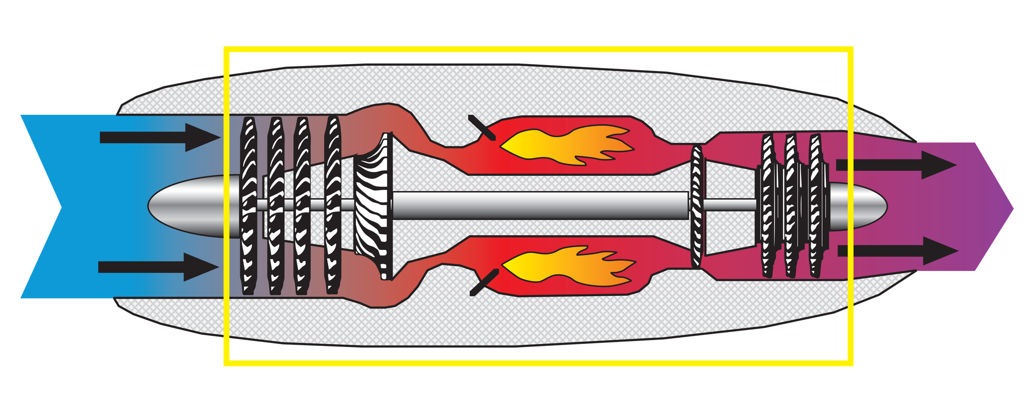
Turbojet
(continued)
FIGURE 3.8
(1 of 3)
Turbine engine comparison showing small turbojet, small turbofan, and turboprop (core turbine engine highlighted in each).

Slide 11
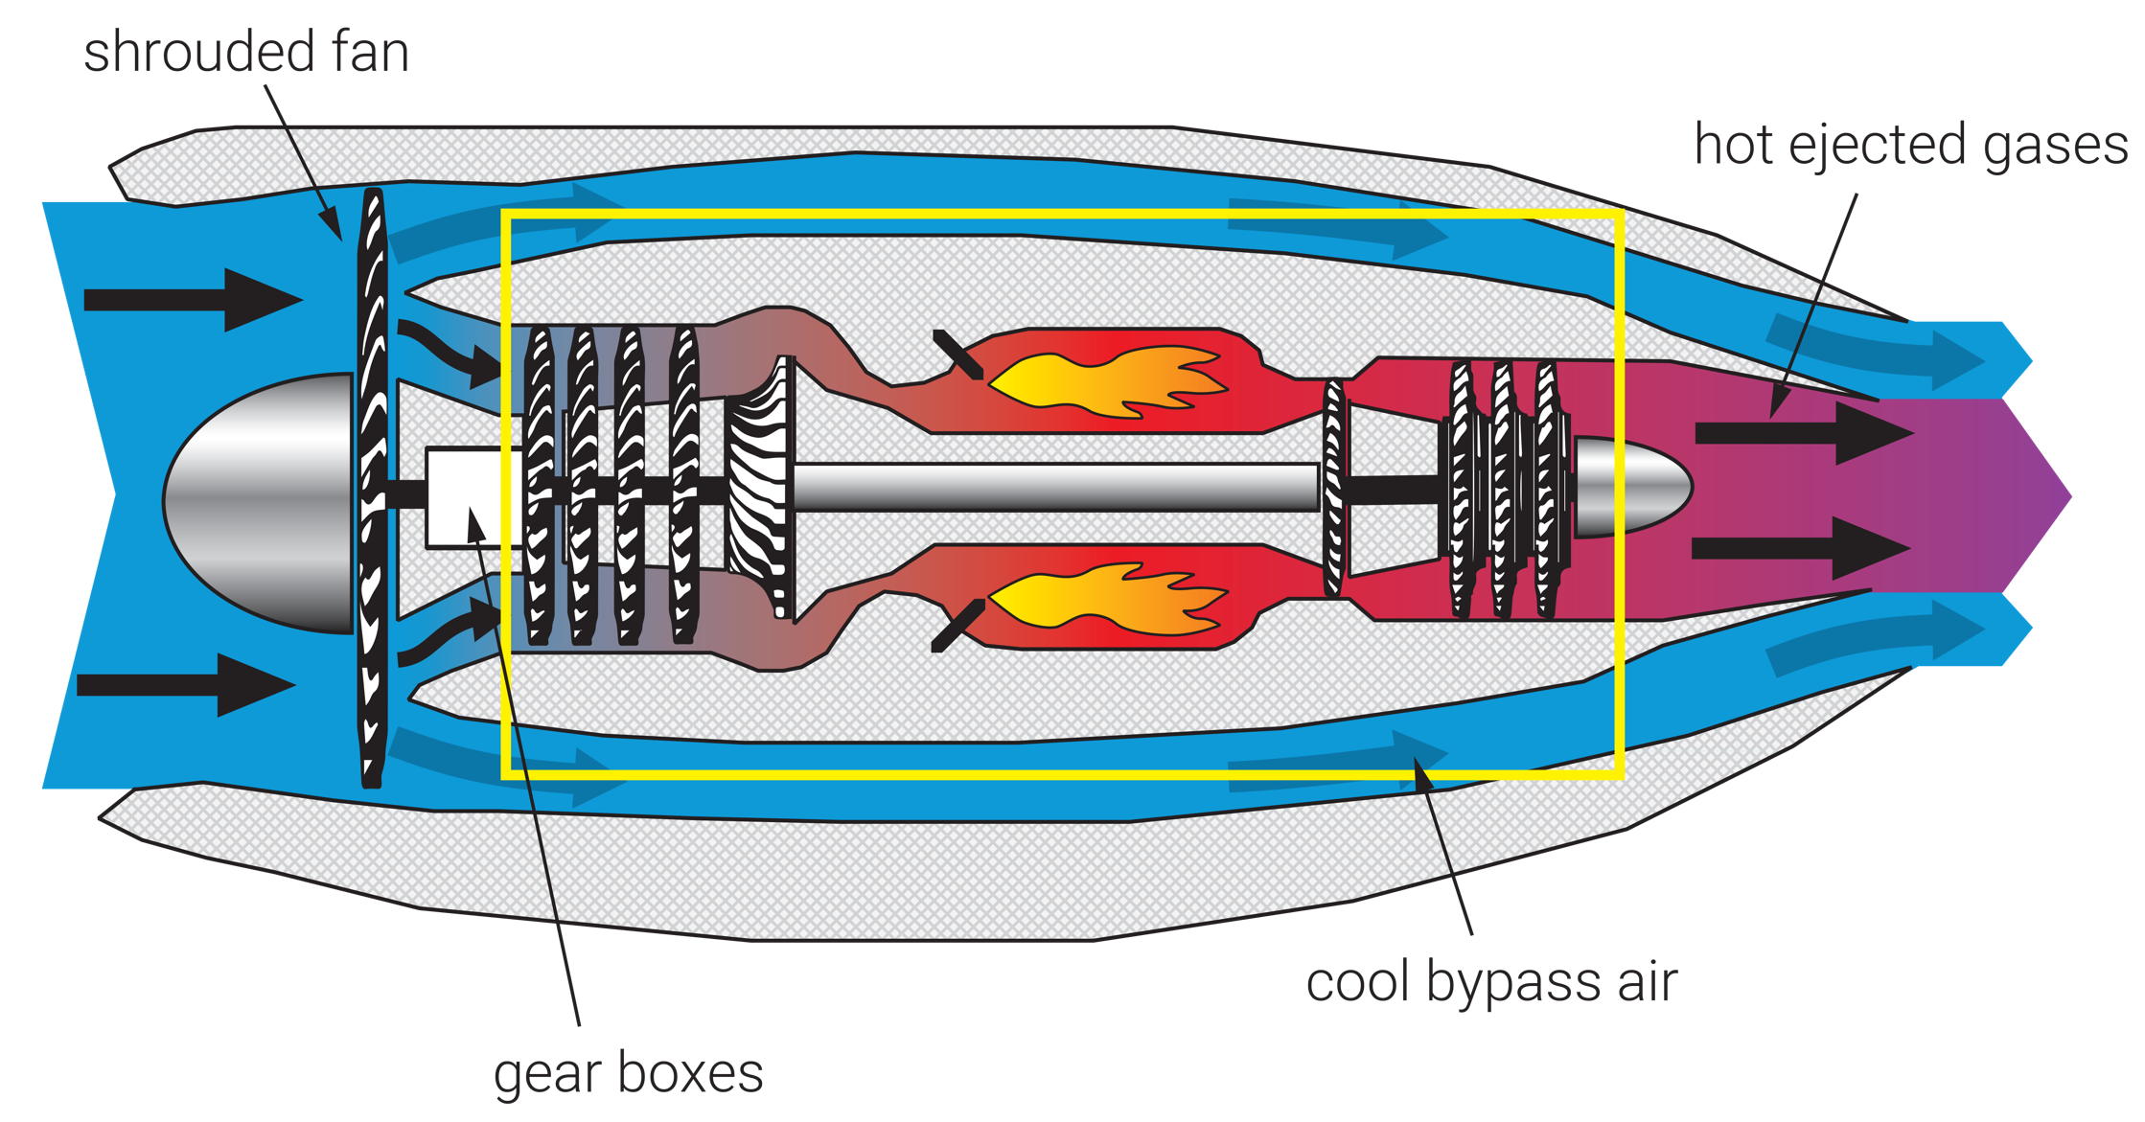
Turbofan
(continued)
FIGURE 3.8
(2 of 3)
Turbine engine comparison showing small turbojet, small turbofan, and turboprop (core turbine engine highlighted in each).

Slide 12
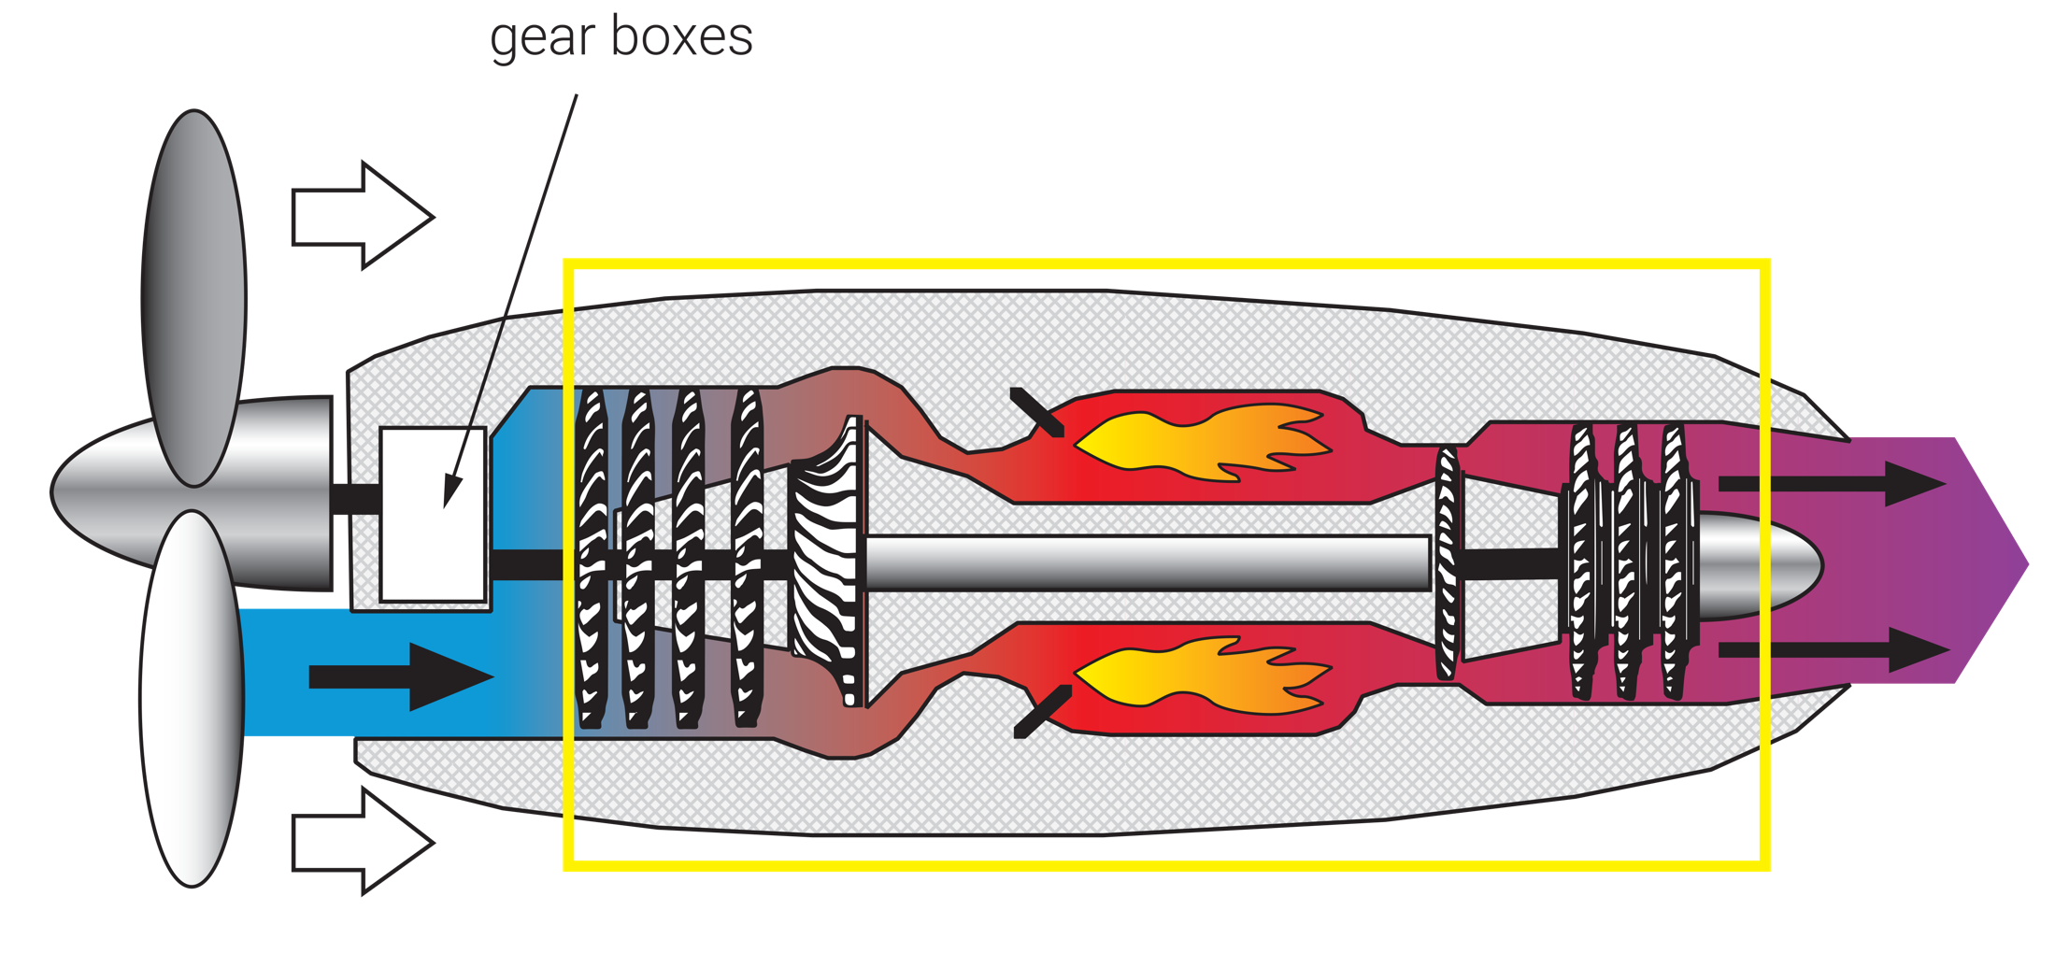
Turboprop
FIGURE 3.8
(3 of 3)
Turbine engine comparison showing small turbojet, small turbofan, and turboprop (core turbine engine highlighted in each).

Slide 13
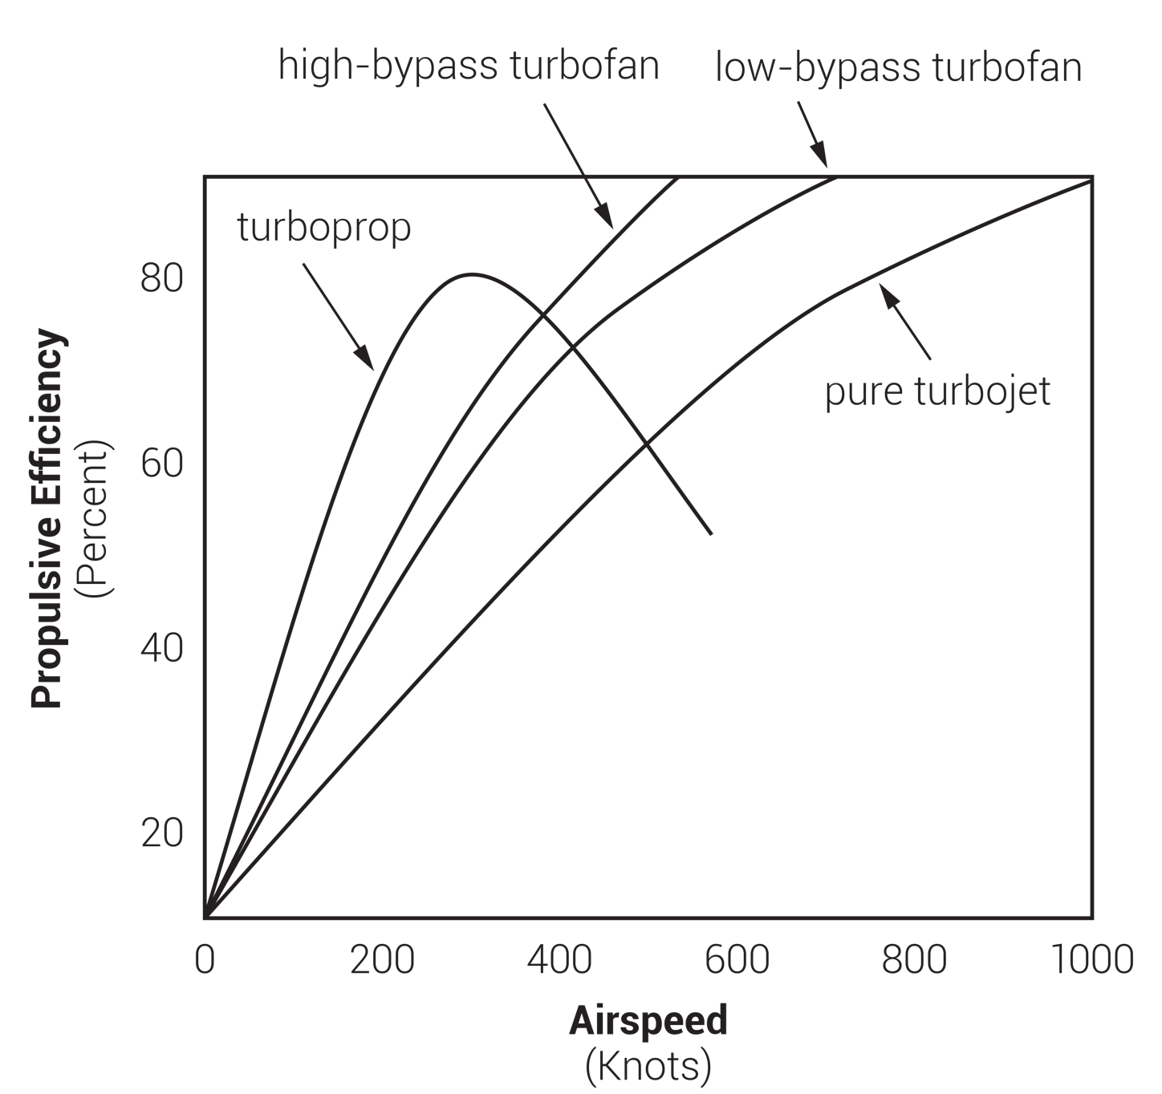
FIGURE 3.9
Turbine engine performance comparison.

Slide 14
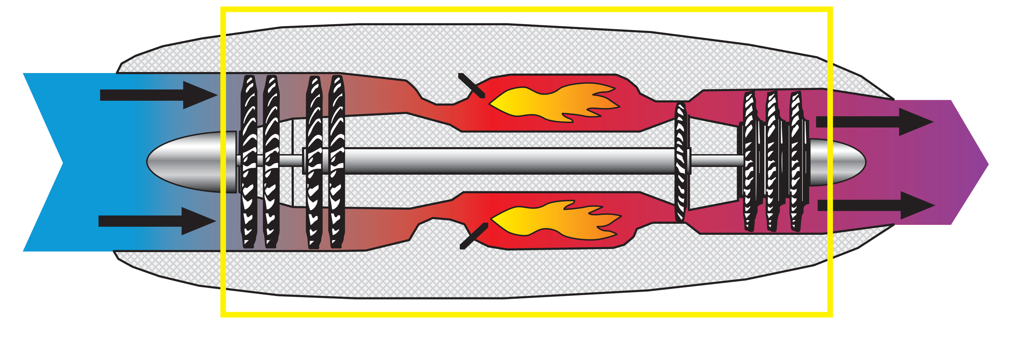
Turbojet
(continued)
FIGURE 3.10
(1 of 3)
Large turbofan (greater than 10,000 pounds of thrust) and geared turbofan engine.

Slide 15
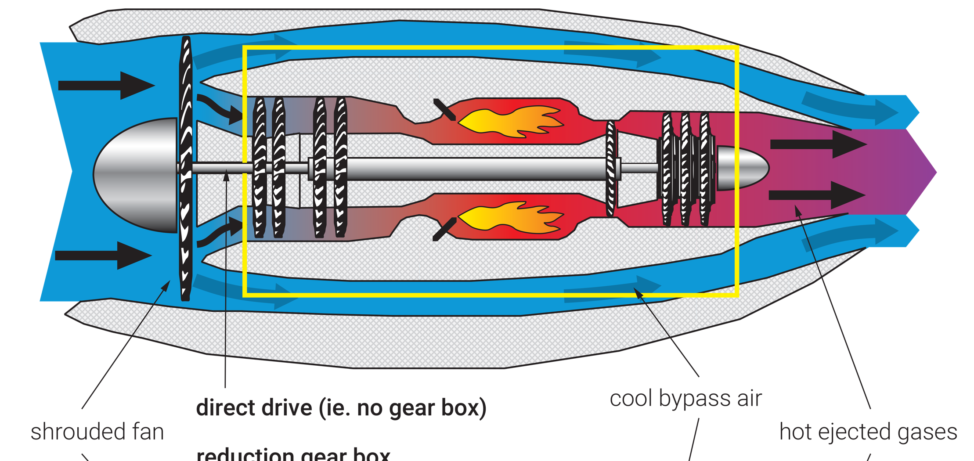
Turbofan
(continued)
FIGURE 3.10
(2 of 3)
Large turbofan (greater than 10,000 pounds of thrust) and geared turbofan engine.

Slide 16
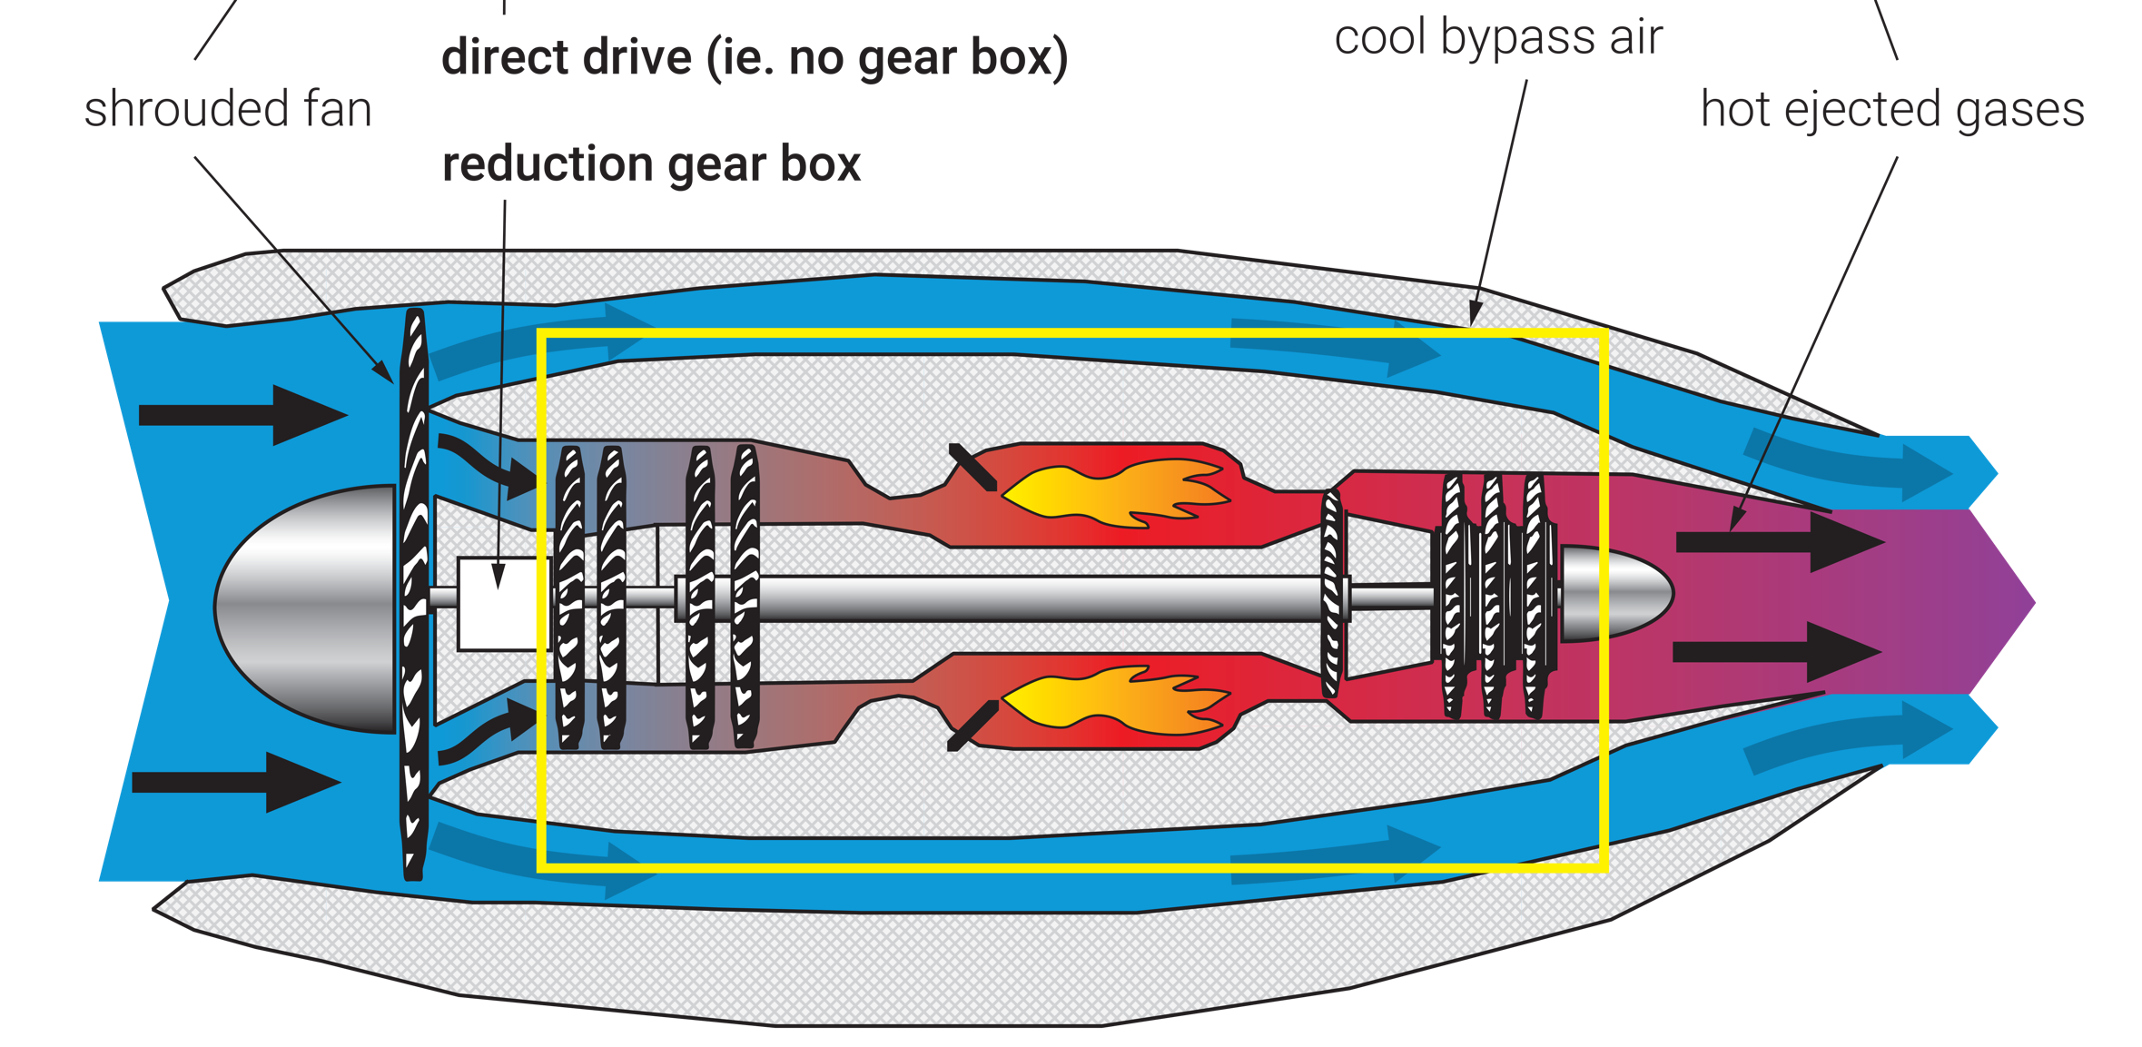
Geared Turbofan
FIGURE 3.10
(3 of 3)
Large turbofan (greater than 10,000 pounds of thrust) and geared turbofan engine.

Slide 17
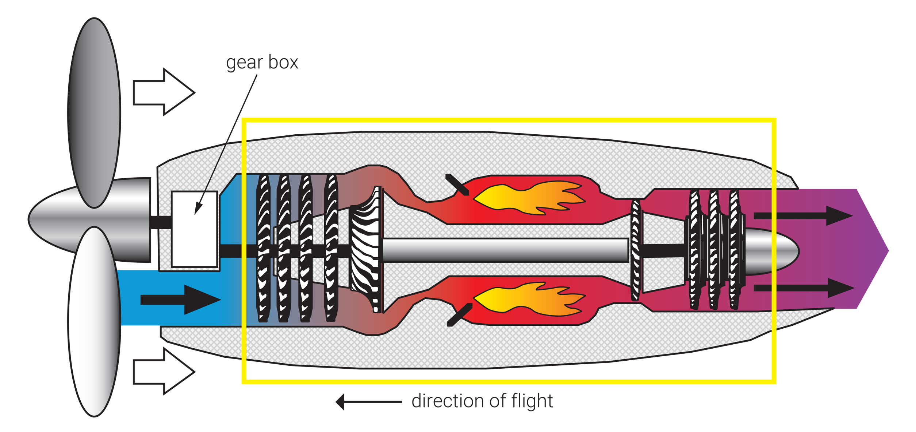
FIGURE 3.11
Direct-drive turboprop engine (core turbine engine highlighted).

Slide 18
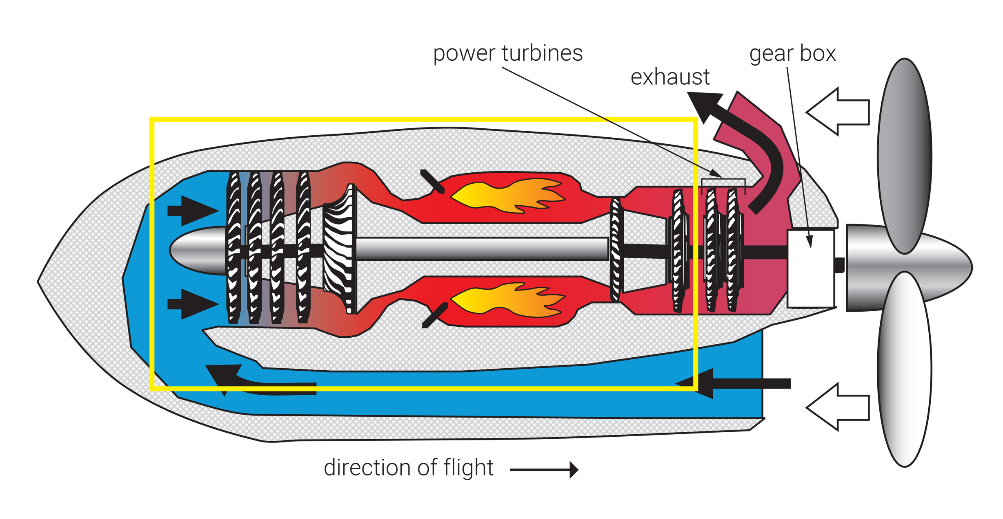
FIGURE 3.12
Reverse-flow, free-turbine turboprop engine (core turbine engine highlighted).

Slide 19
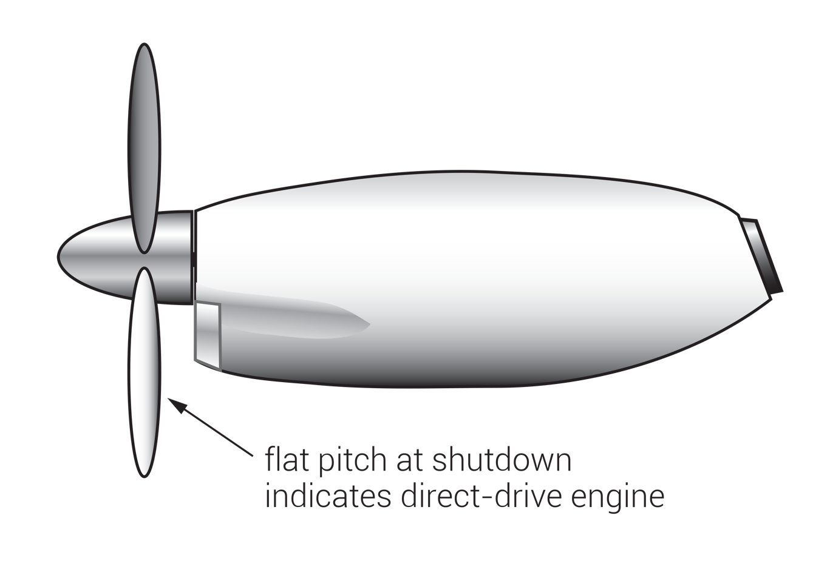
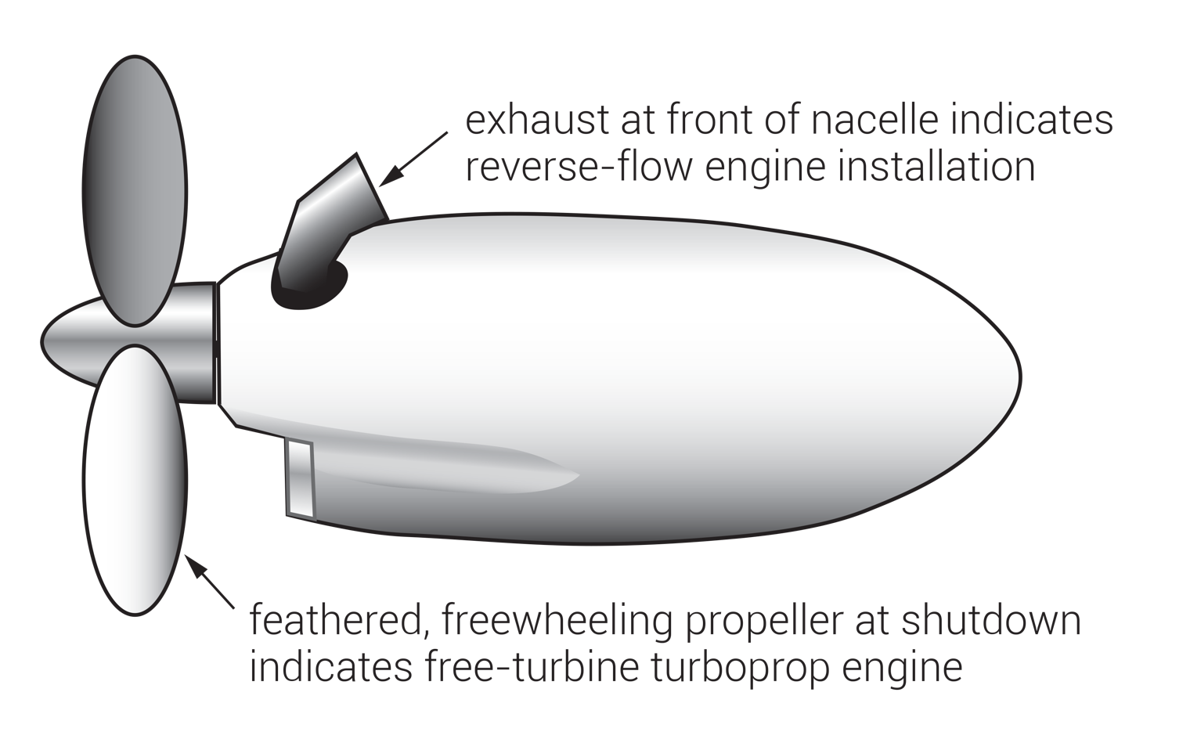
FIGURE 3.13
Differentiating direct-drive from free-turbine turboprop engines after shutdown.

Slide 20
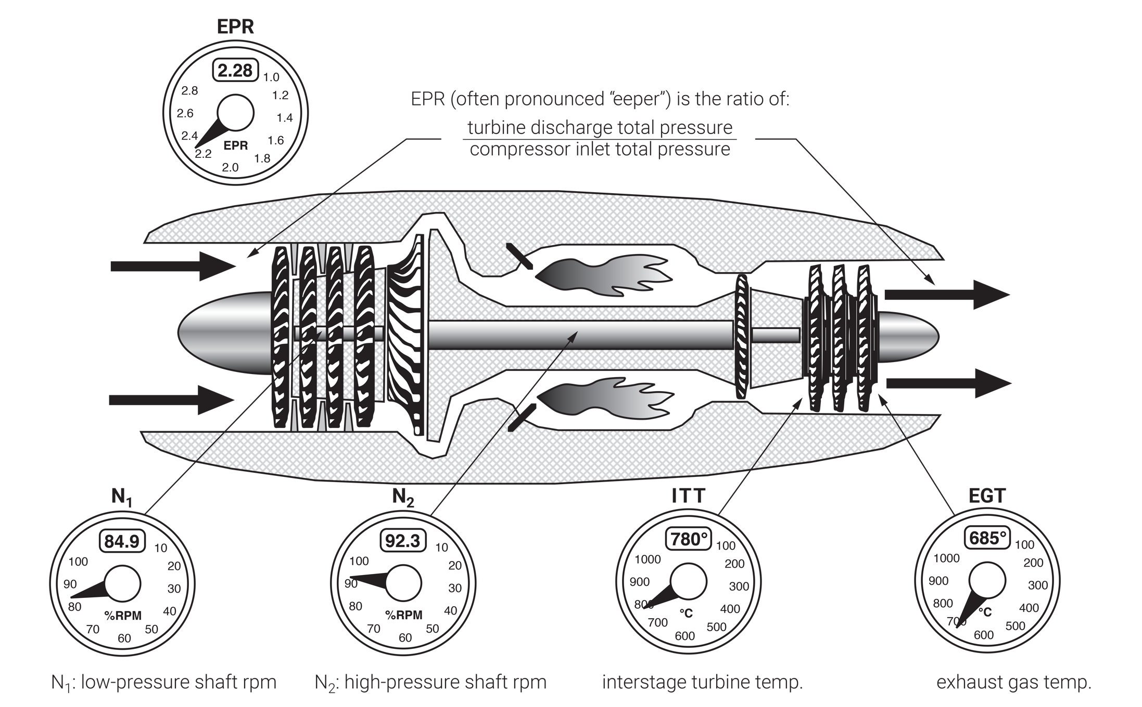
EPR or N₁ indicators are commonly used for setting thrust on jet aircraft. Fuel flow is another measure sometimes used for this purpose. In some aircraft several of these indicators may be used during different phases of flight. For example, while EPR may be calculated and set for takeoff power, fuel flow may be more convenient for targeting airspeeds during approach. Regardless of the measure, thrust is always set using the thrust levers.
FIGURE 3.14
Jet engine powerplant instruments.

Slide 21
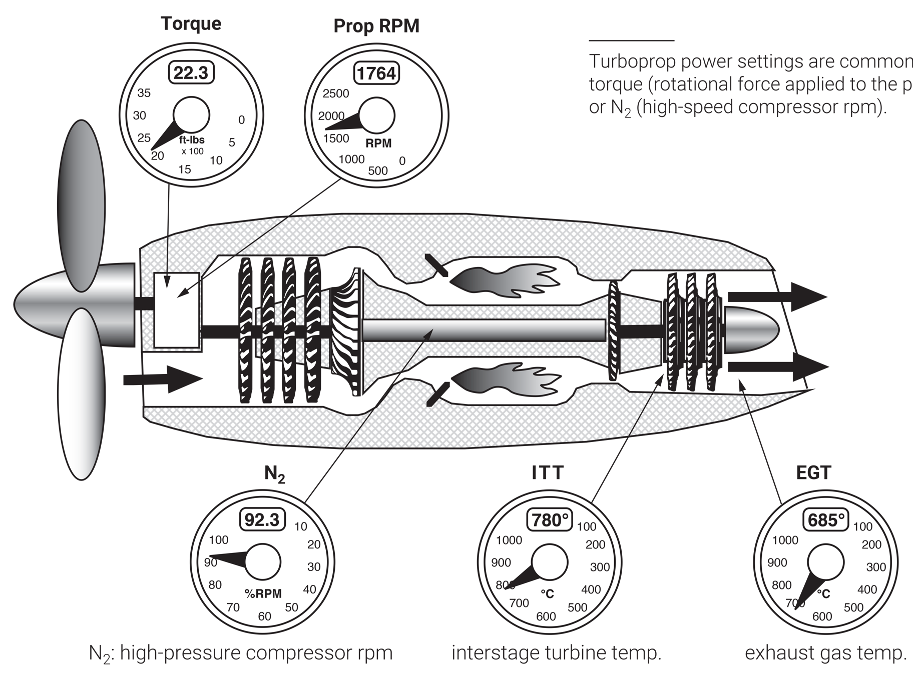
Turboprop power settings are commonly made using
torque (rotational force applied to the propeller shaft) or N₂ (high-speed compressor rpm).
FIGURE 3.15
Turboprop engine powerplant instruments.

Slide 22
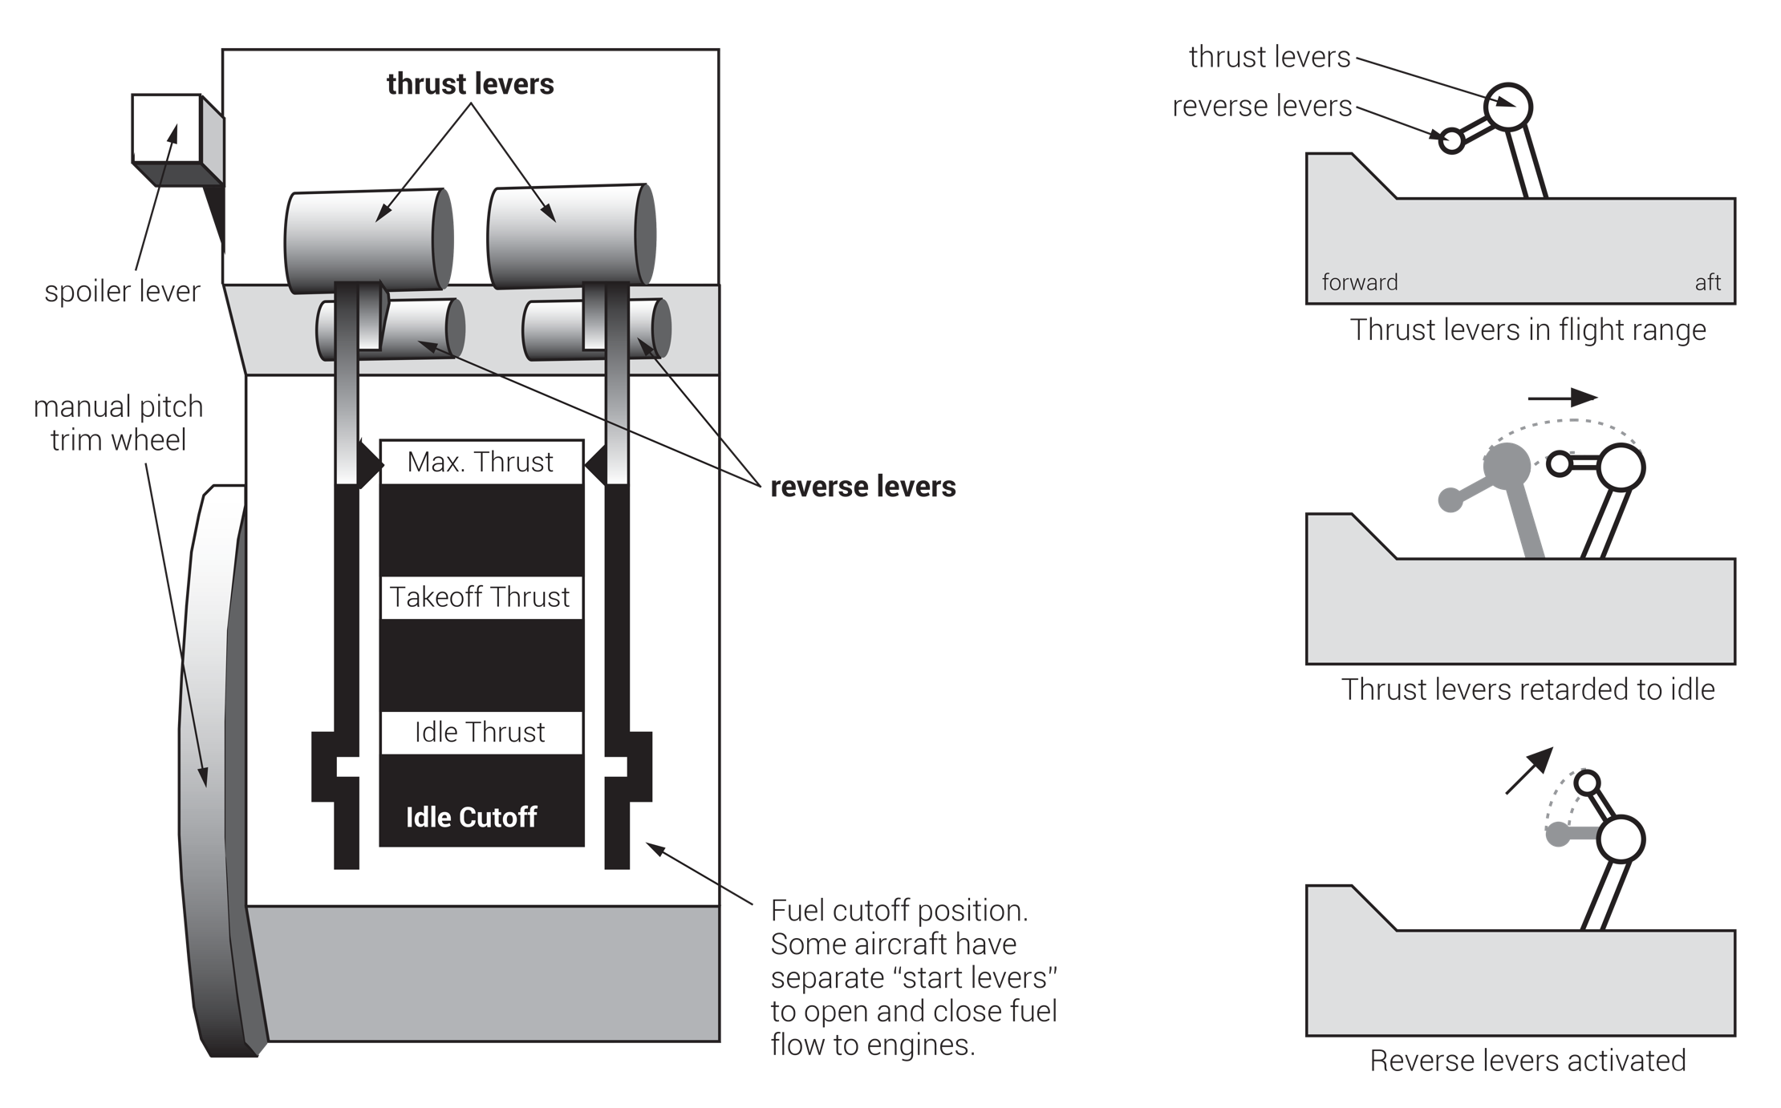
FIGURE 3.16
Jet thrust quadrant.

Slide 23
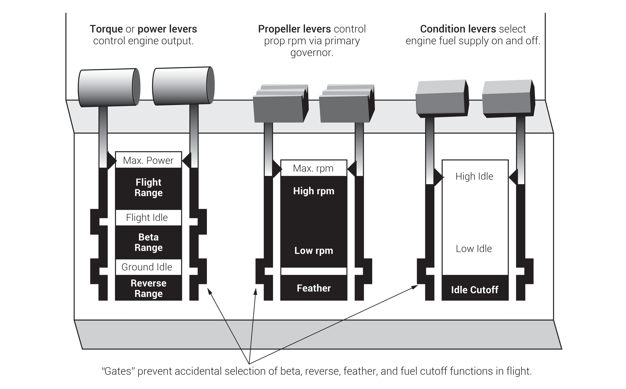
FIGURE 3.17
Turboprop power quadrant.

Slide 24
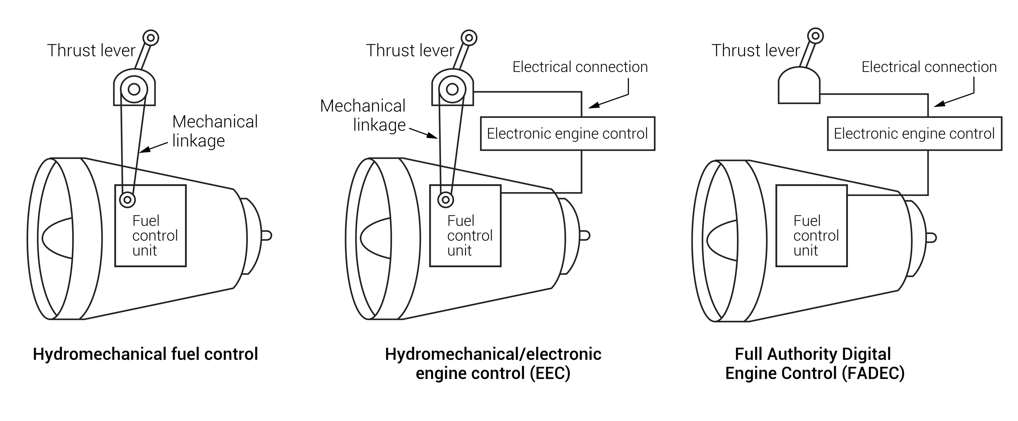
FIGURE 3.18
Engine fuel control unit comparison.

Slide 25
Start sequence: electric start
1. Complete Before-Start Checklist.
2. Check battery condition. (For battery starts, 22V minimum voltage must be available to preclude “hot start.”)
3. Activate electric starter (or starter/generator) and igniters.
4. Starter spins compressor to specified rpm value.
5. Fuel is introduced and secondary igniters activated.
6. Monitor ITT, rpm, and electrical load as they increase. If any value approaches maximum too rapidly, shut off fuel and abort the start. (Severe engine damage can result from a “hot start.”)
7. Electric starter is shut off at predetermined rpm.
8. As temperatures stabilize, reduce power to idle.
9. Complete After-Start Checklist.
Start sequence: pneumatic start
1. Complete Before-Start Checklist.
2. Open pneumatic start valve.
3. Pneumatic starter spins compressor to specified rpm.
4. Igniters are activated and fuel introduced.
5. Monitor EGT and rpm as they increase. If either approaches maximum value too rapidly, shut off fuel and abort the start. (Severe engine damage can result from a “hot start.”)
6. Start valve closes.
7. As temperatures stabilize, reduce power to idle.
8. Complete After-Start Checklist.
Electric starting is common on smaller turbine engines, usually using combined-function electric “starter/generators.” It is preferable to use a ground power source or APU for starting, when available. Battery starts require healthy, fully-charged batteries for “cool starts.” Repeated battery starts are hard on both batteries and engines.
Large turbine engines are started using high-pressure pneumatic power to spin up the compressors. Pneumatic power may be drawn from a ground pneumatic source, from the aircraft’s APU, or from another engine that is already running. Pneumatic “start valve” operation must be carefully monitored to ensure that the start valve closes once the engine’s compressor is spun up.
Turbine engine starting requires a rather long sequence of events that pilots must carefully monitor. On older aircraft most steps must be accomplished manually, with careful timing. Newer systems automate much of the start sequence, but careful pilot monitoring is always required. Among the most serious malfunctions during starting is the “hot start.” This refers to a situation where fuel accumulates in the combustion chamber at an excessive rate, resulting in engine temperatures that can severely damage internal parts. Pilots are trained to monitor engine temperatures and rpm trends, in order to abort starts early when indicated.
FIGURE 3.19
Typical turbine engine start sequences.

Slide 26
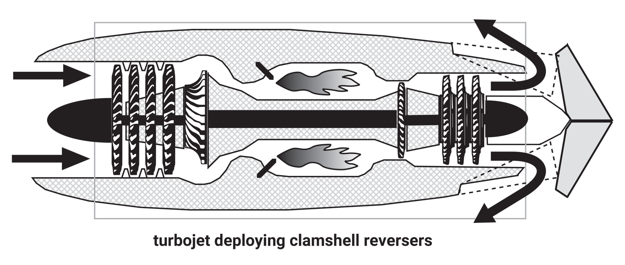
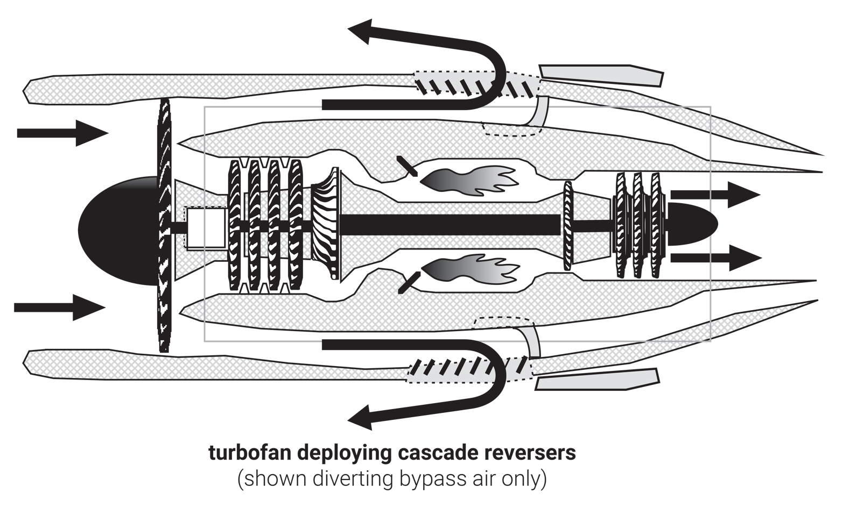
FIGURE 3.20
Two types of jet thrust reversers.

Slide 27
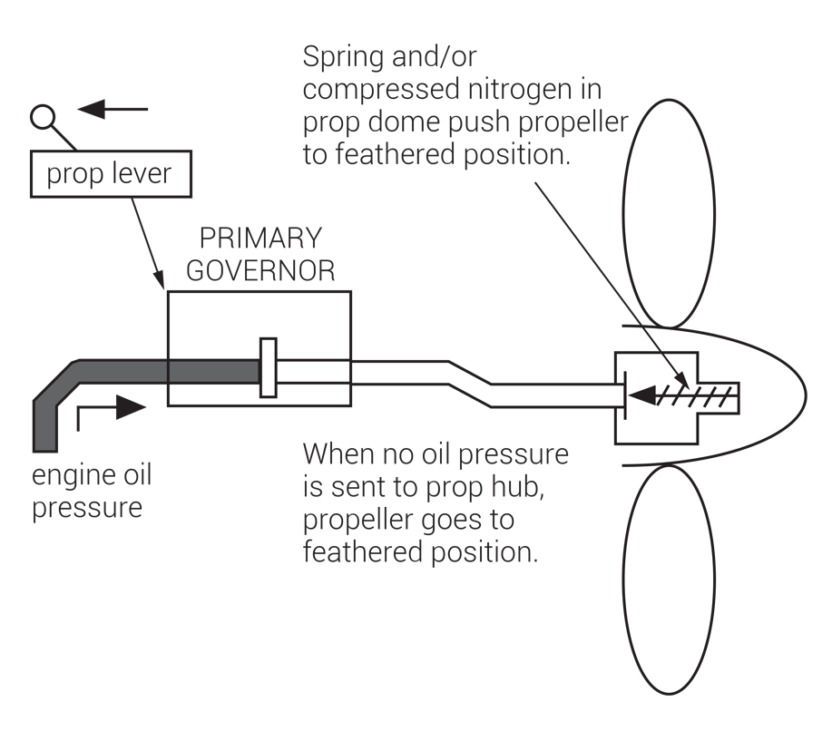
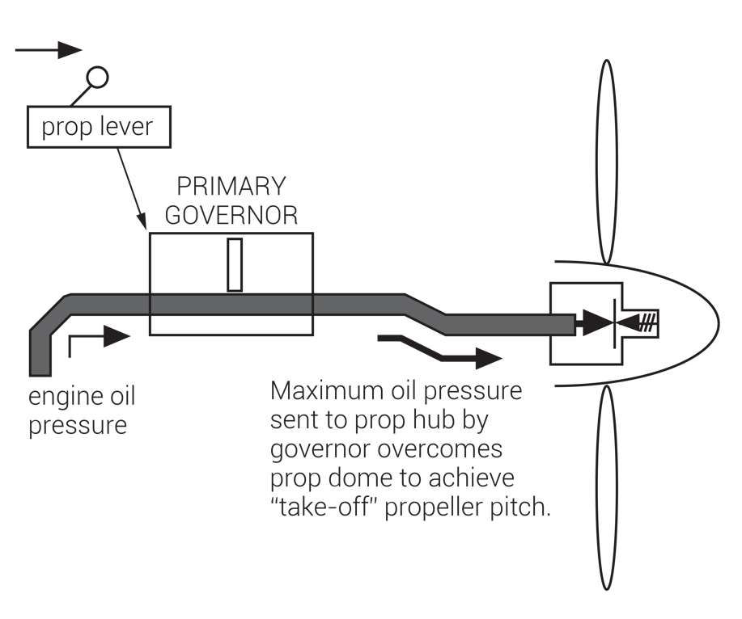
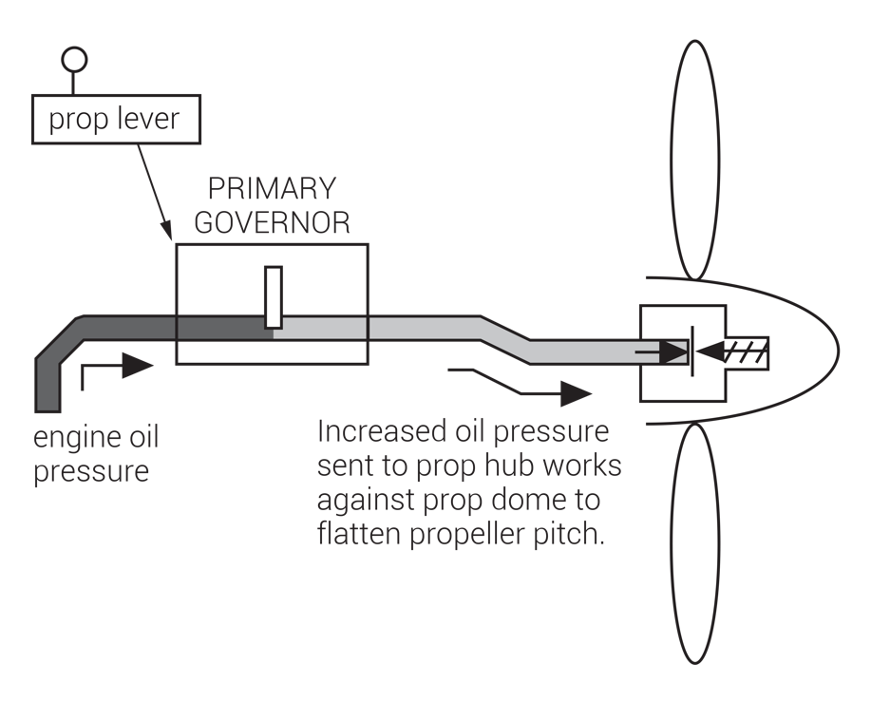
FIGURE 3.21
In flight, the primary governor uses engine oil pressure to control propeller pitch.

Slide 28
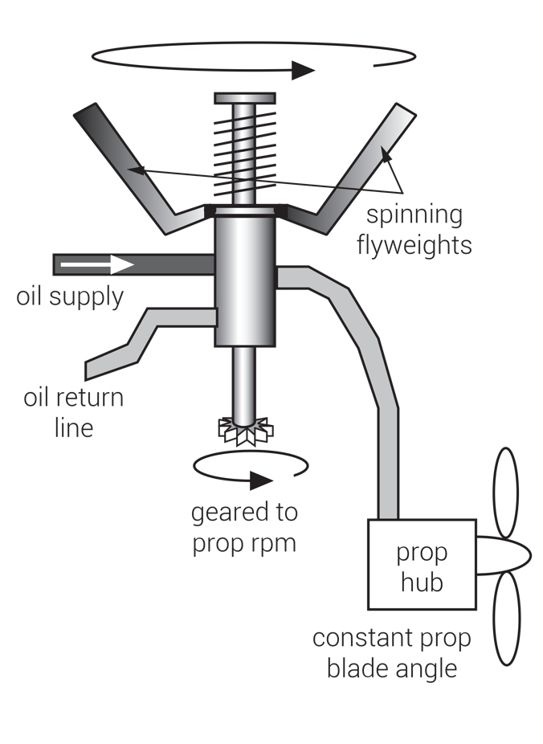
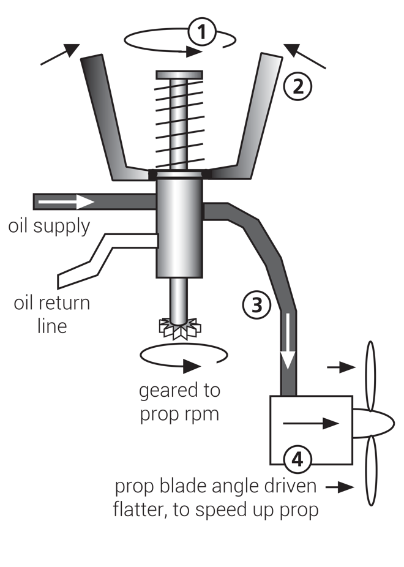
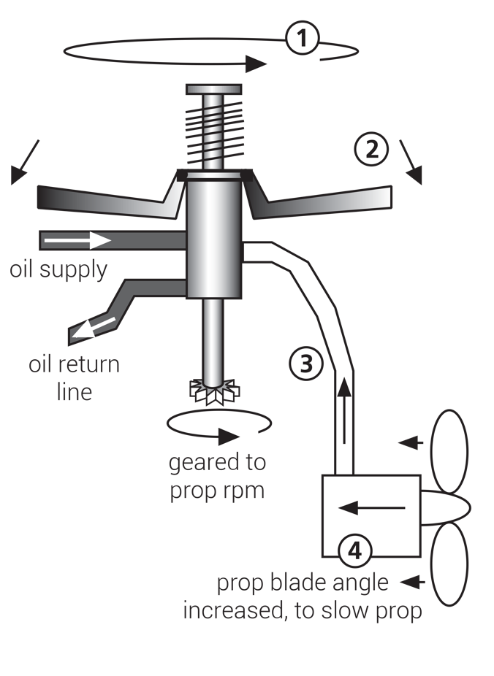
Prop on speed, as selected by pilot prop lever. Since governor rotation is constant and as selected, flyweight positions remain steady. Oil pressure to prop hub, and therefore prop pitch and rpm, are constant.
Prop underspeed, relative to selected rpm.
1. Since it’s geared to prop speed, governor rotation slows down. 2. Slower governor rotation causes flyweights to retract. 3. Retracting flyweights open valve, sending more oil pressure to hub. 4. Higher oil pressure flattens prop pitch. Flatter prop generates less rotational drag, so prop speeds back up to selected rpm.
Prop overspeed, relative to selected rpm.
1. Since it’s geared to prop speed, governor rotation speeds up. 2. Faster governor speed causes flyweights to extend. 3. Extending flyweights close valve, reducing oil pressure to hub. 4. Lower oil pressure drives prop pitch toward feather. Drag of steeper prop pitch slows prop to selected rpm.
FIGURE 3.22
How a primary governor works (turboprop engines less than 2,000 shp).

Slide 29
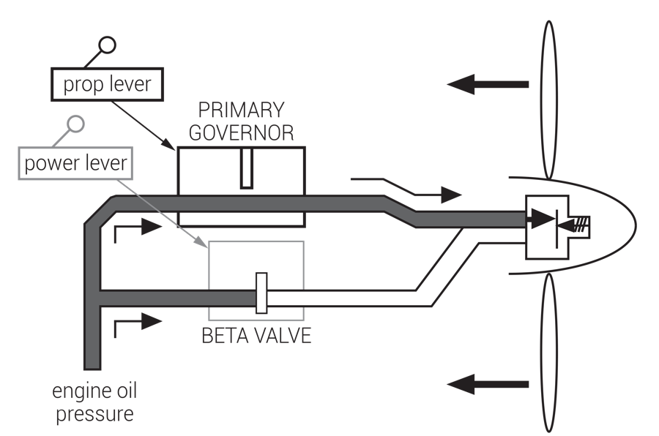
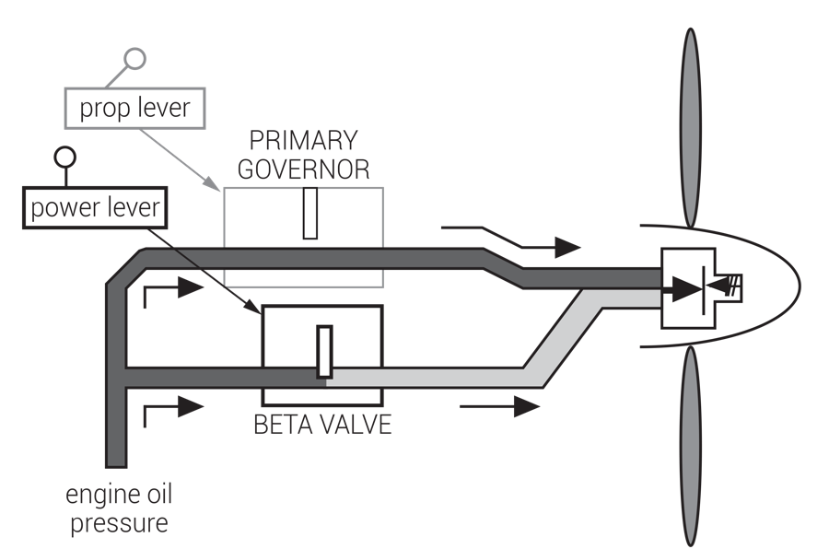
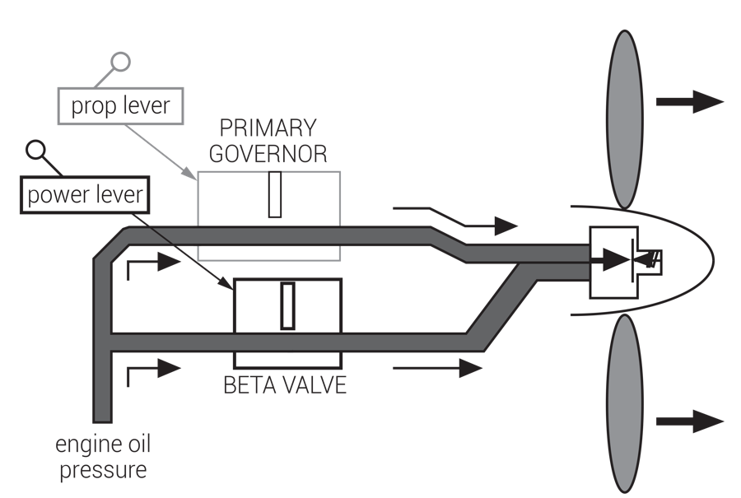
In flight range, prop levers set “full forward” send maximum oil pressure from primary governor to prop hub, overcoming prop dome to achieve “takeoff” propeller pitch. This is the “flattest” safe in-flight prop pitch setting.
On the ground, flatter pitch is useful for slowing the aircraft on landing and taxi, due to high turbine engine idle speeds. The beta valve, activated by the power levers, sends additional oil pressure to the prop hub, flattening pitch to around 0°. Beta range is sometimes known as “ground range” or “ground fine.”
In reverse, the power levers further open the beta valve, driving prop pitch to negative blade angles. Prop levers remain full forward in “beta” and “reverse.”
FIGURE 3.23
Beta valve directs additional oil pressure to the prop hubs for ground and reverse operations.

Slide 30
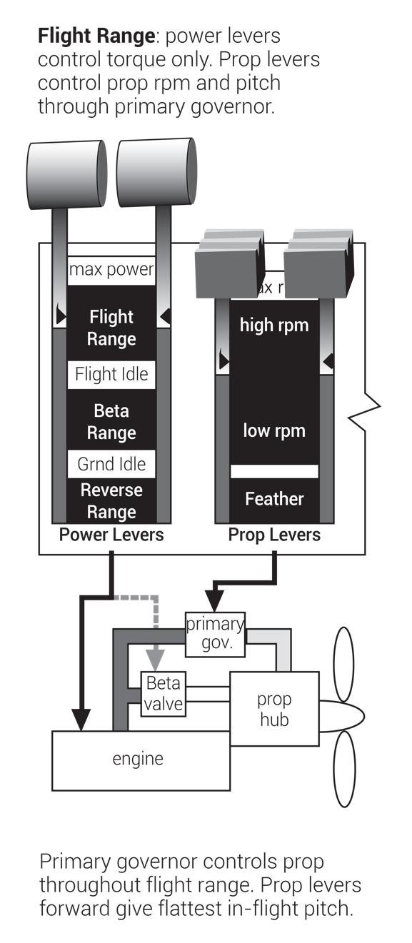
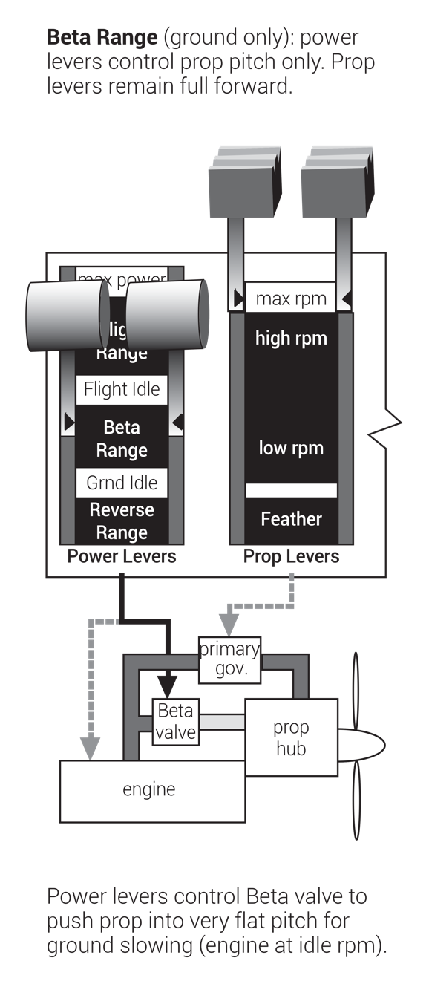
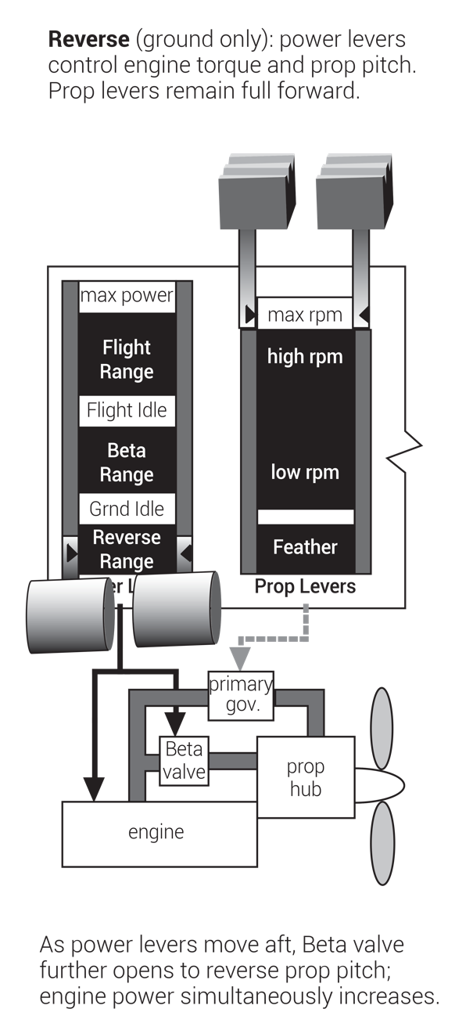
FIGURE 3.24
Power levers control beta valves.

Slide 31
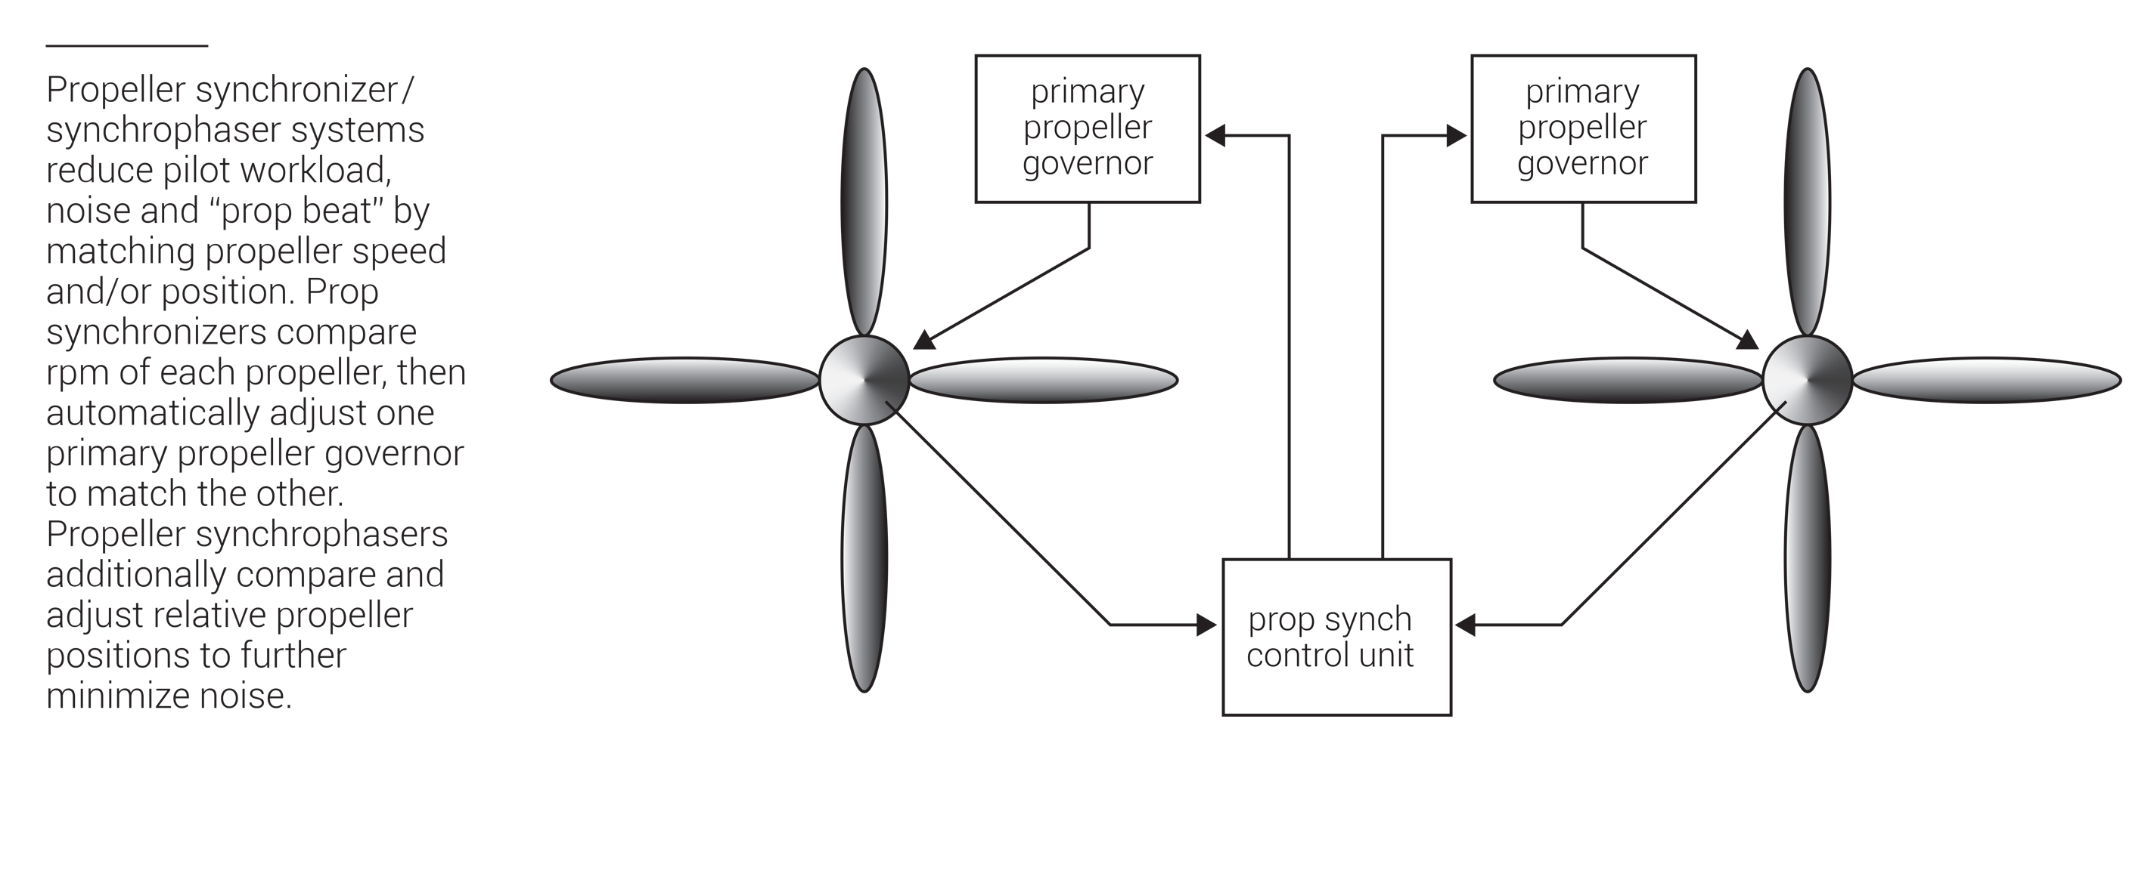
FIGURE 3.25
Propeller synch on multiengine aircraft.

Slide 32
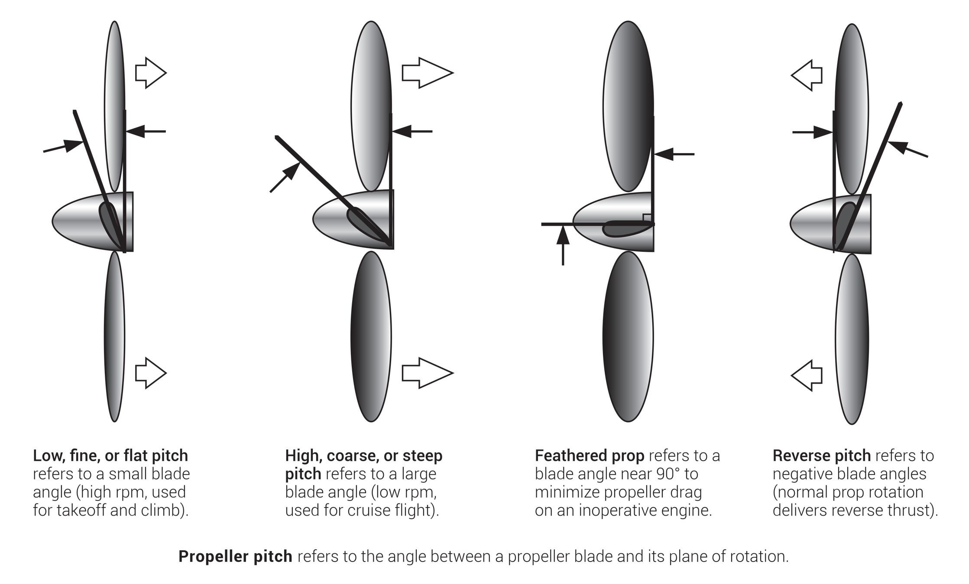
FIGURE 3.26
Propeller pitch.

Slide 33
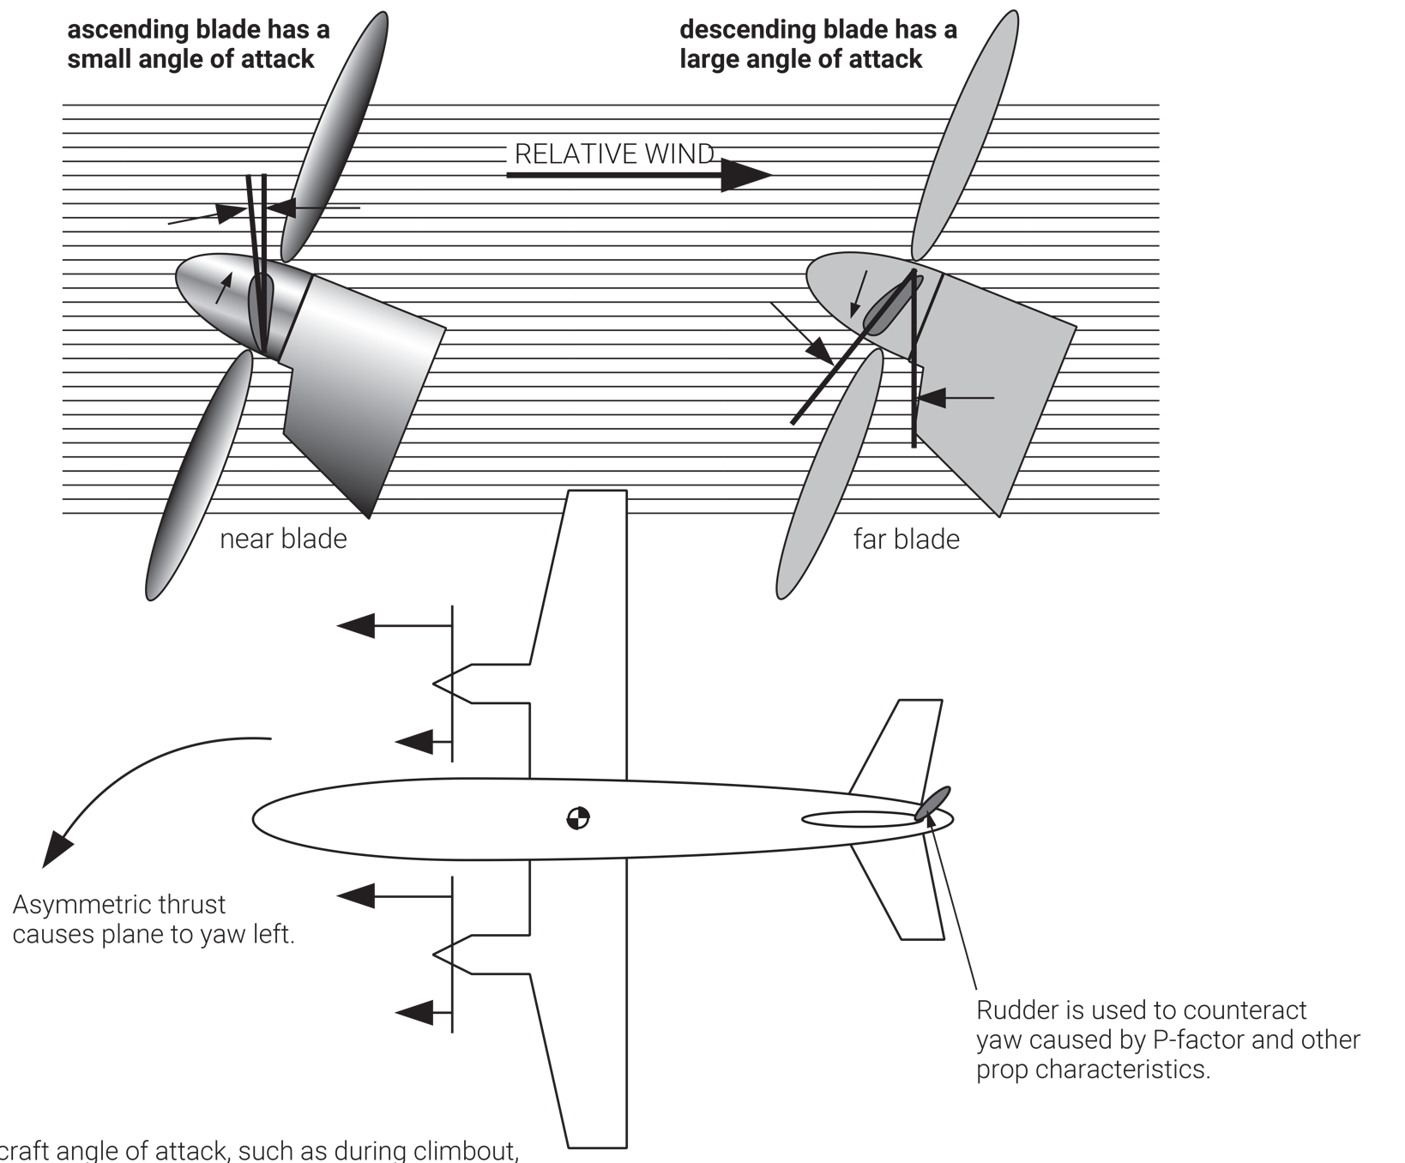
At high aircraft angle of attack, such as during climbout, ascending and descending propeller blades have different angles of attack. The resulting asymmetric thrust must be counteracted with rudder.
FIGURE 3.27
Propeller P-factor. (Figure and comments depict clockwise-rotating propeller installation, as viewed from behind.)

Slide 34
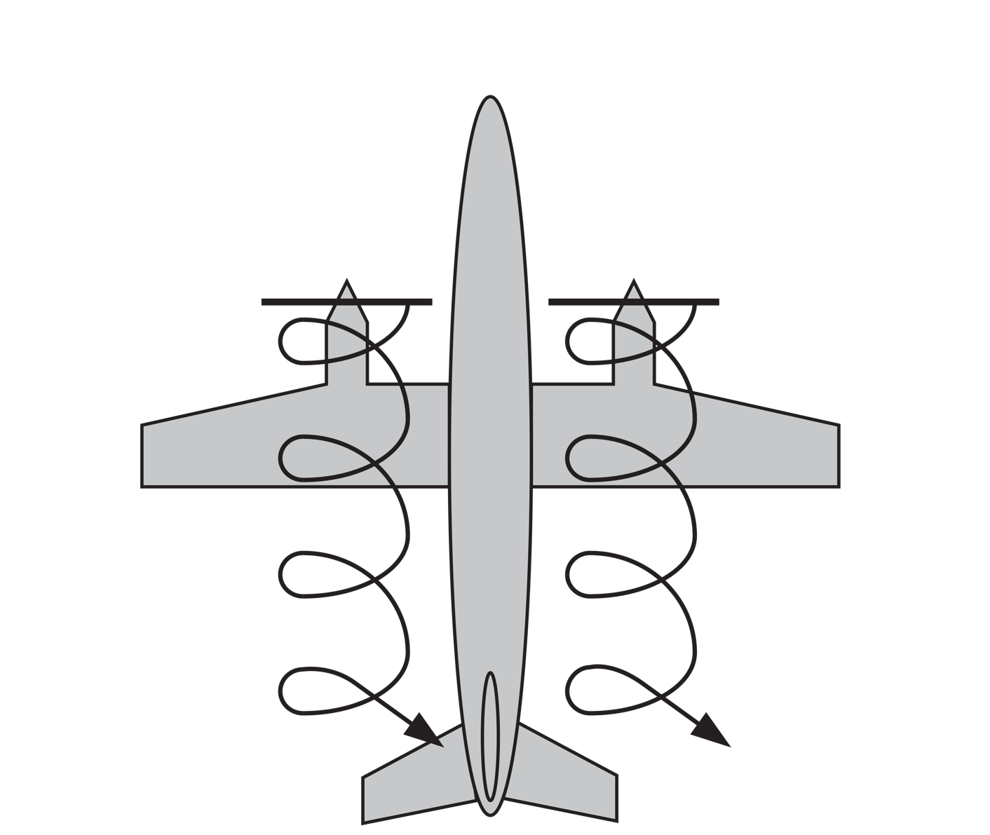
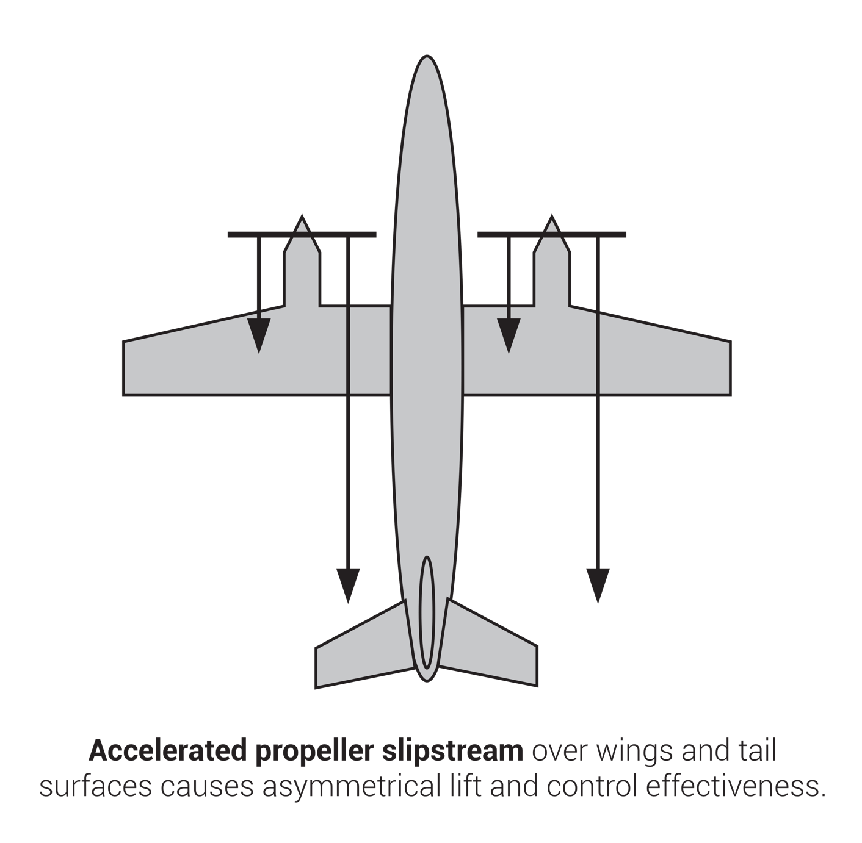

FIGURE 3.28
Propeller slipstream effects.

Slide 35
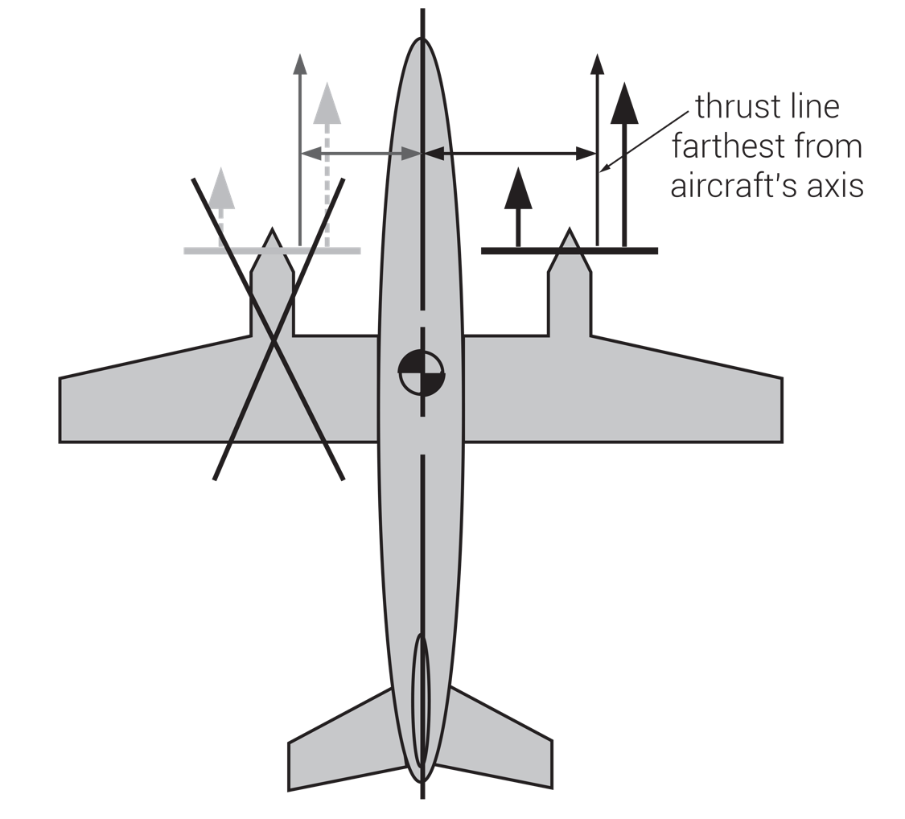
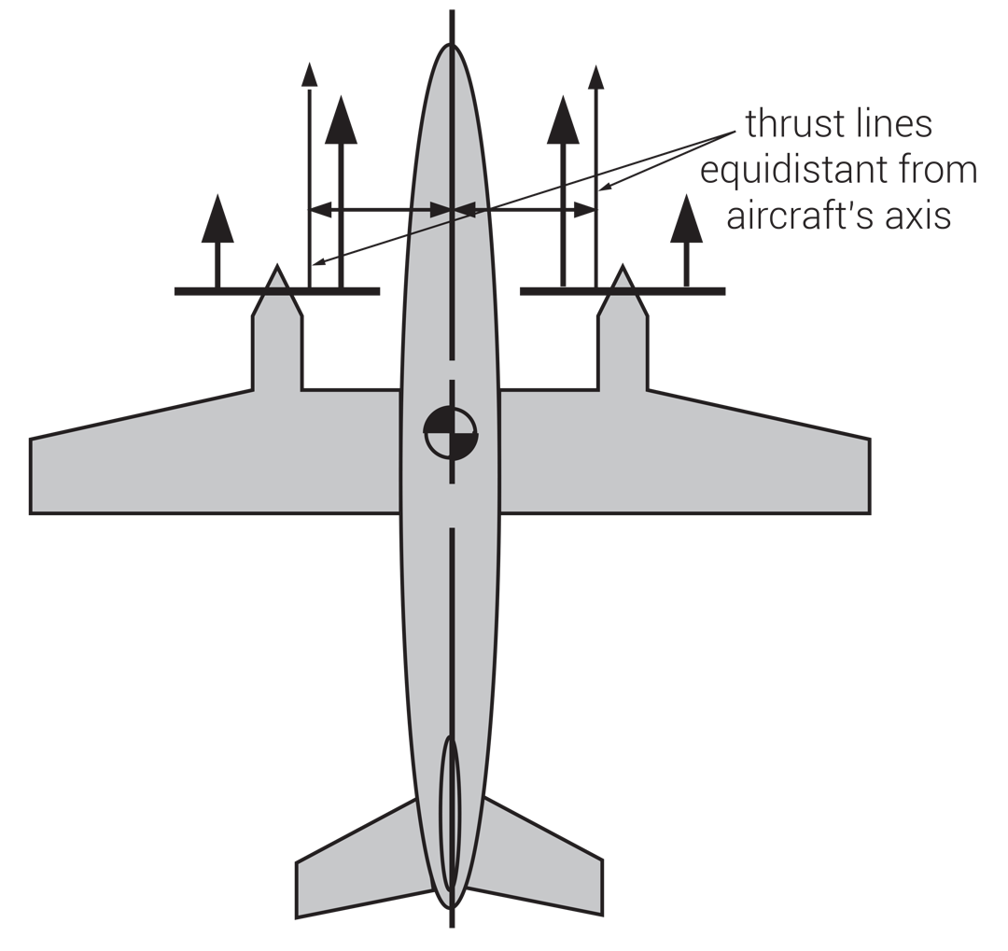
On twin-engined aircraft with clockwise-rotating propellers (as viewed from behind) the left engine is the critical engine. Since the right engine’s thrust line is farthest from the aircraft’s longitudinal axis, failure of the left engine creates the strongest yawing tendency.
On aircraft equipped with counter-rotating propellers, performance is affected equally by failure of either engine. Therefore such aircraft have no “critical engine.”
Due to P-factor and other propeller effects, failure of one engine often results in greater aircraft yawing tendency than failure of the other. The engine whose failure most adversely affects flight performance on a given aircraft is known as the “critical engine.”
FIGURE 3.29
Critical engine on propeller-driven aircraft.

